Slide 1
Rescued Moments in art
Terry Harbinson
Notes:
Hi, my name is Terry Harbinson and I work as an artist, although in former lives I have been a researcher in a number of Universities and at a research Institute after which, I became a teacher and retired as Assistant Headteacher in a Comprehensive School, where I taught Chemistry. However, the one constant throughout my life has been painting, which I have done from being a child. Fascinated by the painting of the great masters, I used to try to draw and paint copies of them, but it wasn’t until I tried to paint a little more seriously that I began to develop my own style. The title of this presentation is ‘Rescued moments’; this may appear as a trite sentiment, but it really goes to the heart of the types of painting I try to create and I hope this will become clear as this presentation unfolds.

Slide 2
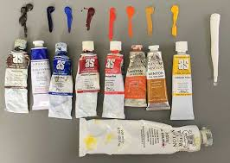
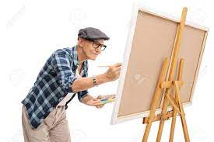
About me
What do I do?
What is my medium?
What is my preferred painting surface?
Notes:
My main areas of work are landscape and still life and I have always been inspired and informed by the methods and ideas of masters, both old and contemporary. I work in is oil using liquin, a medium, which is fast drying but maintains the gloss of the paint. I paint usually on canvas although I also paint on panel. The differences between these two surfaces is that canvas has texture and tooth, panel does not. The advantage of panel is that it gives painting longevity since the paint does not crack with time, and since board has no ‘tooth’ it facilitates the painting of detail. Owing to its texture, canvas drags paint from the brush better than board, but can lose its stretched firmness with age. sometimes my decision as to which surface to use is dictated by the dimensions of the composition. If it’s a non-standard size, it is easier to cut board and prepare it with gesso than to stretch canvas then prepare it. Six months after a painting is completed, I will then varnish it. This period allows the paint to fully dry and oxidise. The varnish enhances the rich appearance with a satin or gloss finish and protects the underlying painting from dirt and moisture.

Slide 3
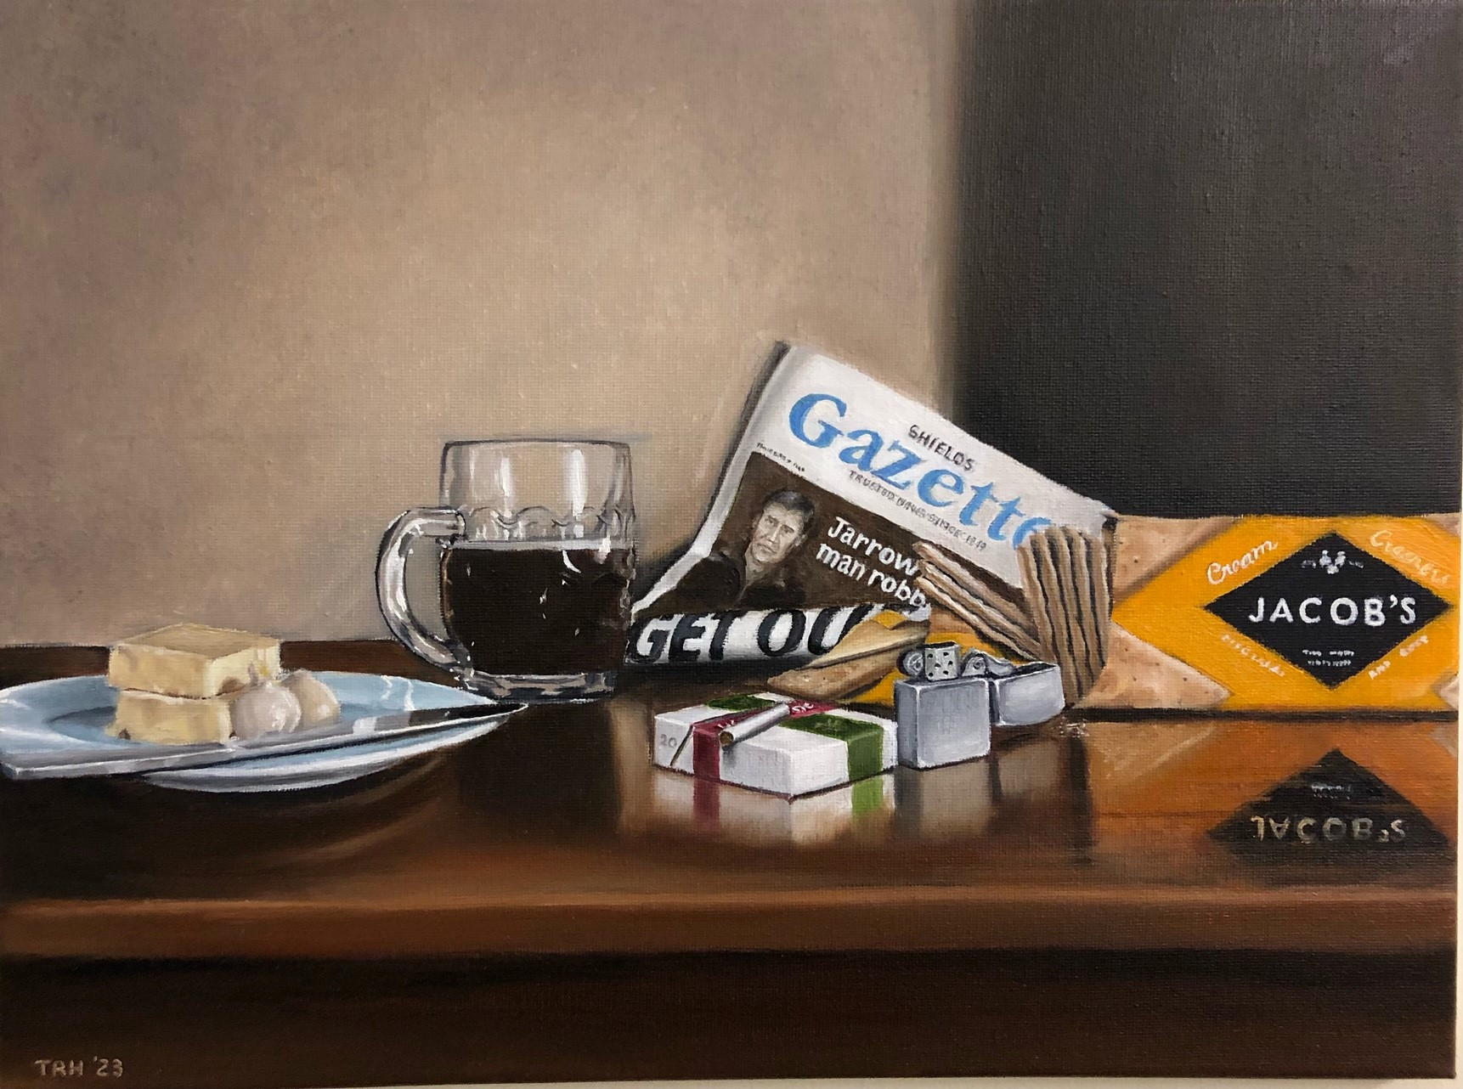


Notes:
Some of today’s painters can render figures and objects as well as the masters of the past, but cannot produce paintings as lasting or as good. The reason lies in composition-how the painting is put together. The old masters discovered that placing objects or figures within certain geometric shapes and harmonic intervals (like the distances between frets on an a guitar) were the secrets of great composition and that when objects or figures were placed together and painted in these ways, they became pleasing upon the eye. I try to incorporate these ideas into some of my paintings, particularly still life. As you can see from one of my still life paintings entitled 8.30pm Friday night, Salem Street, Jarrow the distance between the horizontal lines follow the harmonic intervals which follow the musical scale. The diagonal lines across both side of the Shields Gazette form a triangle with the top of the harmonic line that goes across the base of the biscuit packet, the beer glass and the cheese, drawing in one’s eye and giving the composition focus. The master painters recognised that geometry and the distances in the musical scale all contribute to achieving good composition since they focus the eye and draw it into the painting. It is this that the old master’s mastered and is why they regarded the three major elements of painting to be a) drawing b) Composition and c) Colour

Slide 4
How do I paint?
Drawing the image I wish to paint
Transfer the image to canvas
Block in, in neutral colours rough areas of shadow and light
Apply and paint in the objects in the painting paying attention to value and degree of coolness or warmth I want
Add detail
Fine detail
Notes:
incorporate these ideas. So my first endeavour is to draw up the composition
The drawing is usually detailed and shows my initial thoughts as to how the painting will finish. It describes the planned composition of the painting.
I will then transfer this image onto the canvas/panel usually by tracing it
Once I have the image in place I will use a thin mixture of umber (brown and medium to block in where the values on the painting (areas of light and dark which give form to the painting and make it look 3d). I’ll talk about this more in a moment. If I am not happy with the composition, it is at this point that I will make changes.
Once dry I will then begin to paint colour thinly onto the painting, taking account of the areas of light and shade, reflected light etc. Then I will go over with thicker layers of colour. Once this is dry I will then look at the painting again to see if any minor changes are needed.
Now comes the point using a finer brush that real detail is applied, greater blending of colour is performed.
Finally, fine detail is applied to highlight and give realism to the painting.

Slide 5
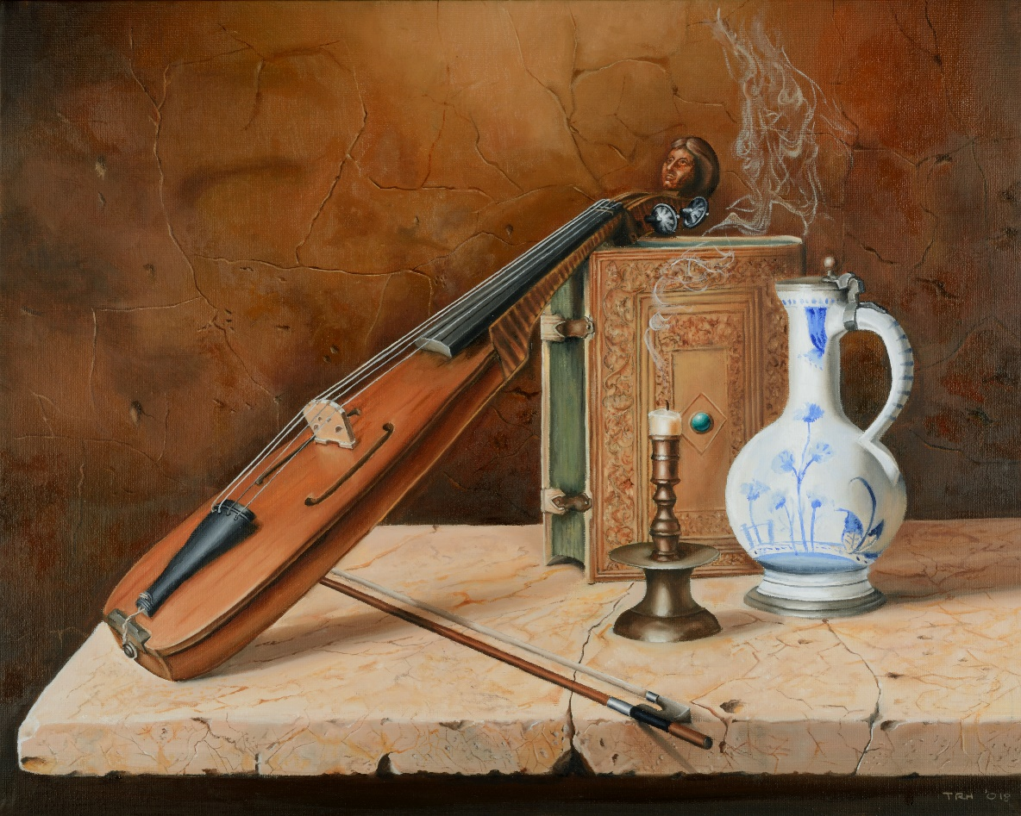
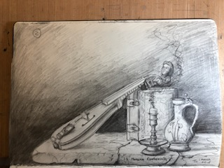
Notes:
Painting is a bit like reading a historical novel there is a lot of truth in there but there is some license as well and this is particularly true of landscape painting and certainly my own. It allows the artist to be creative with the subject and composition and not just create a photographic portrayal, because If that is what you want, just take a photograph instead!
In my paintings I am trying to look at subjects in a way that may have gone unnoticed revealing a rescued moment from the myriad of images that pass or have passed us by in daily life.
With regard to this, I am trying to capture the interaction of light with forms and how it affects our perception of places.

Slide 6
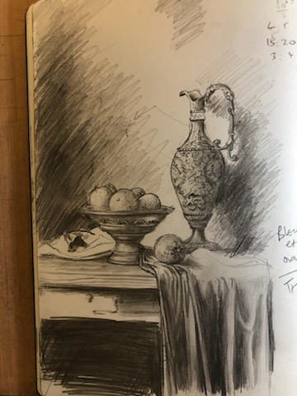
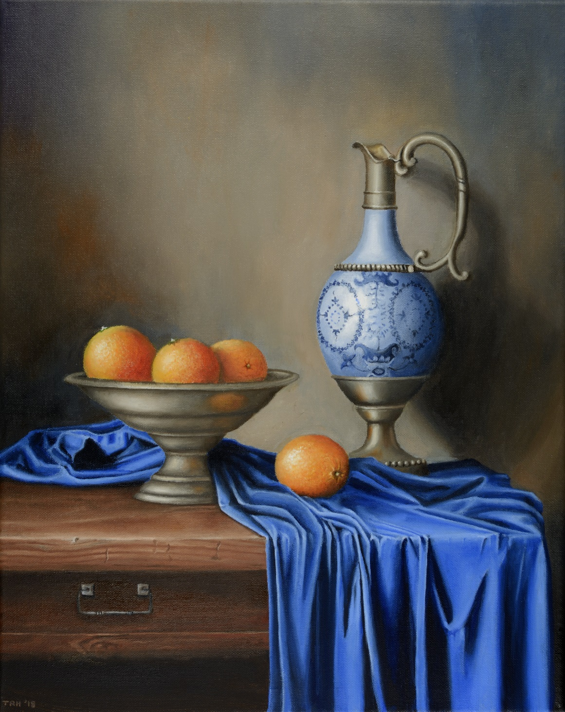

Slide 7
What do I mean by rescued moments?
As an artist what am I trying to do?
Notes:
Light gives value (value means how dark or light a colour is) and therefore gives shape to objects. It allows them to portray 3d space on a 2d surface
Light is the fundamental building block of art and key to composition and story it tells. If we look at one of my still life paintings named ‘Fresh picked’ we can see this (slide 8). The darkening of the satsuma oranges, the darkening of the coffee pot and folds in the table cloth helps us to see the whole as a3-d image. The mirror shows me painting the scene and is inspired by the idea from Van Eyck’s painting of the marriage of Arnolfini, where the artist is shown in the mirror behind the couple. Again, a captured moment, the artist painting the artist at the time of painting.

Slide 8
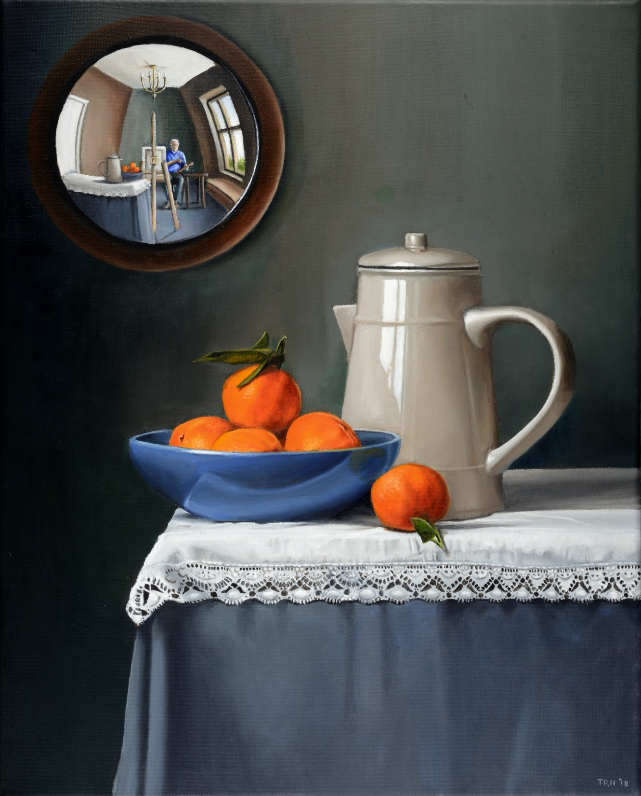
Notes:
In the light of what I have said what can you say about the following paintings from my exhibition
Get participant responses

Slide 9
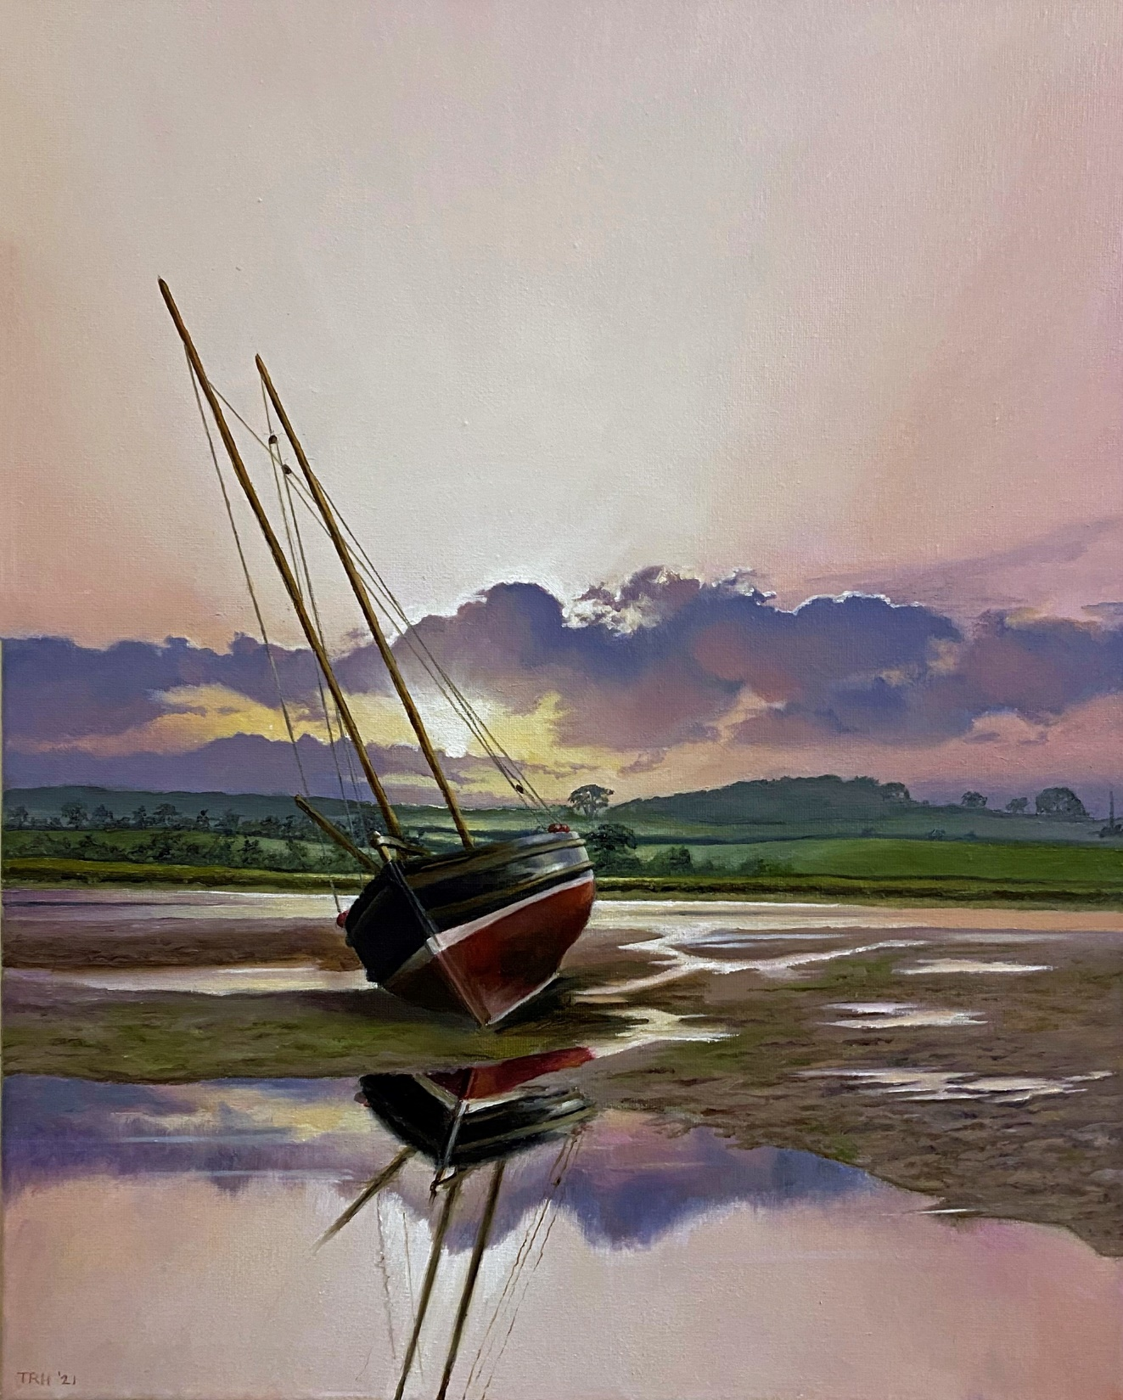
Notes:
This slide shows one of the paintings I am currently showing at North Tyneside General Hospital as part of my exhibition celebrating the landscape of the North East of England: ‘Sea-carved coastline, moor and mountain’.
It shows Alnmouth estuary at dawn and I think it exemplifies what I have been trying to say above. Those who have visited Alnmouth may have passed this or many boats like it many times. This painting is about the effect of dawn light on the scene, so over half of the composition concerns the sky. If we look closely, a cone of light emerges from the sun, gradually widening and thrusting the darkness to the outer extremities of the canvas. It spells awakening. It dapples the fields and water surrounding the leaning boat and it’s as if the boat itself is about to awaken from sleep to another working day on the coming of the tide.­

Slide 10
Light and painting
What does light do to a painting?
Notes:
However, light not only affects the mood of the painting, but when combined with the nature of the composition of the painting can affect the mood of the viewer. If we look at two landscapes from my exhibition.
The one on the left is of Tynemouth priory the one on the right is of Embleton bay.
Imagine yourself in the scene portrayed in each canvas, how does each make you feel?
Get participant responses
In the Tynemouth priory canvas, I have attempted to suggest the moment of an impending storm on King Edward’s bay, the shafts of light piercing the priory ruins are almost giving to the painting a gothic feel; The darkening of the clouds suggest an imminent cloudburst. The combination of these factors and the suggestion of a gale stirring the sea, gives to it a sense of raw, elemental violence.
In Embleton bay, painted on panel, I am suggesting a moment in the burgeoning dawn, where the soft light of the rising sun is reddening the darkness and pushing it back from the centre-left of the panel. The clouds are touched with this soft light as is the sea, a single wave gently breaks on to the beach. All these factors coming together suggest and capture a moment of tranquility.
If you ask me, I’d be content to be part of this moment but distinctly on edge in the one conveyed in King Edward’s bay!
Get participant responses

Slide 11
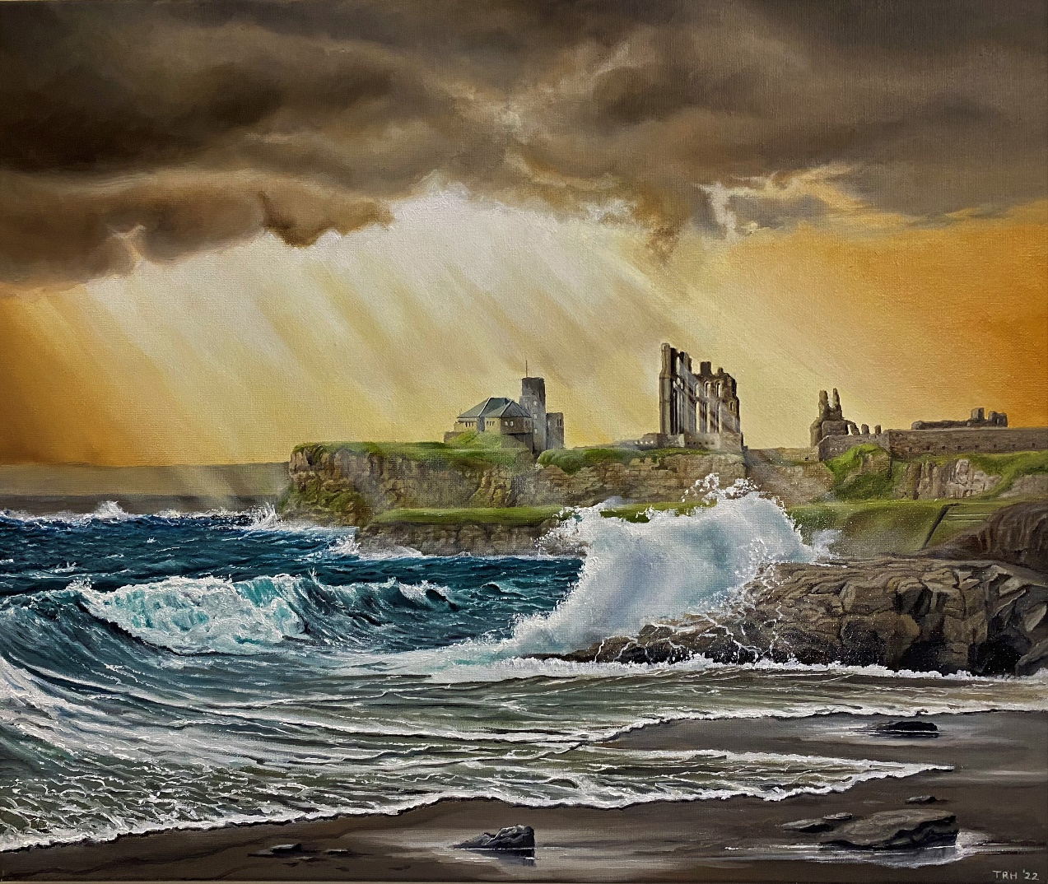
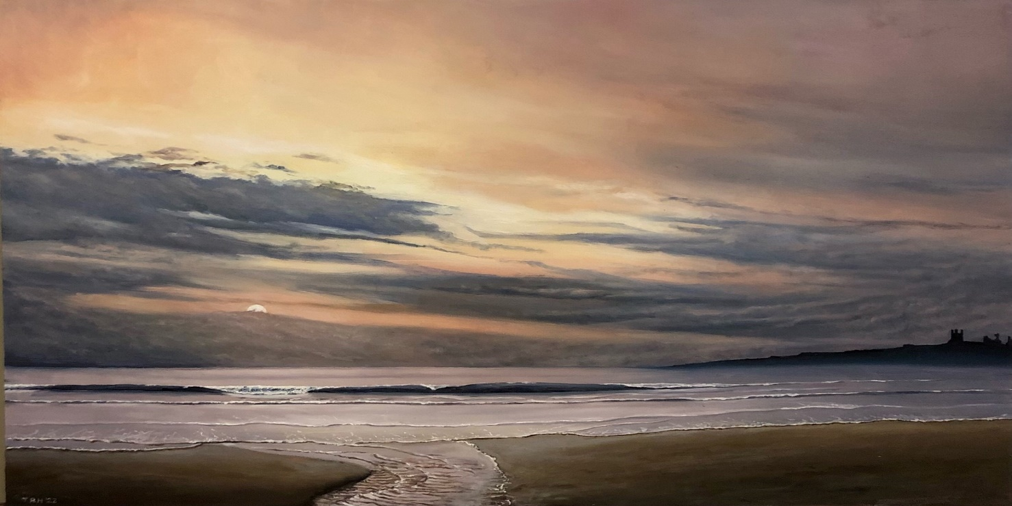

Slide 12
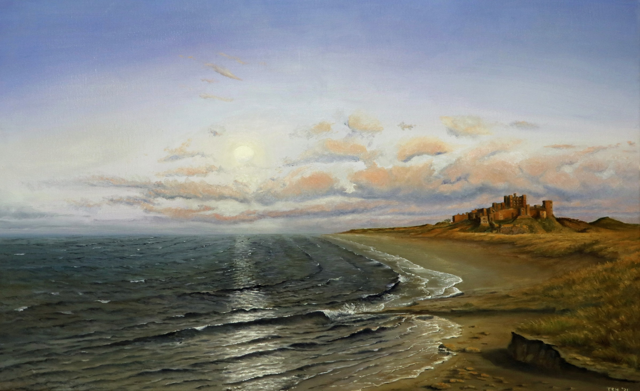

Slide 13
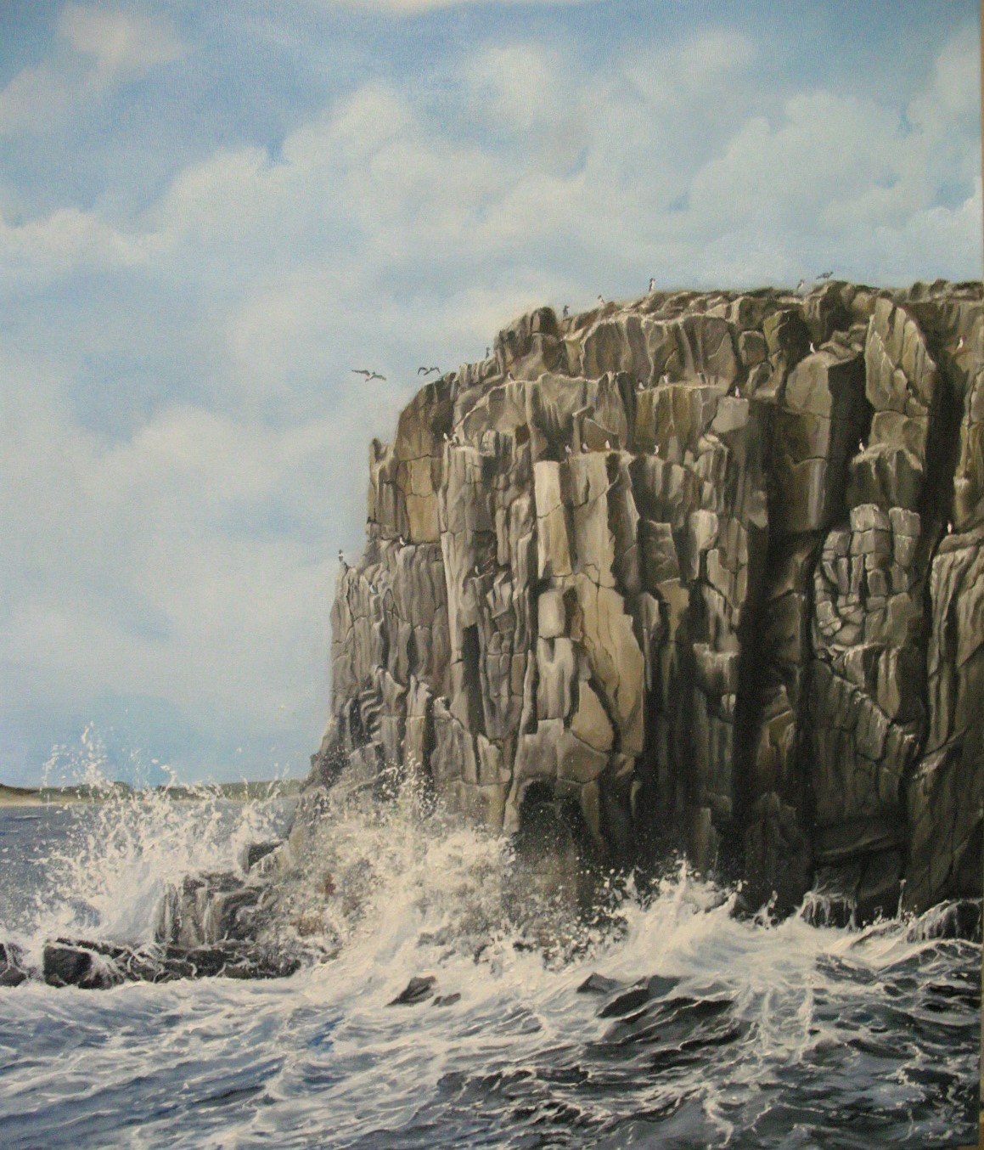

Slide 14
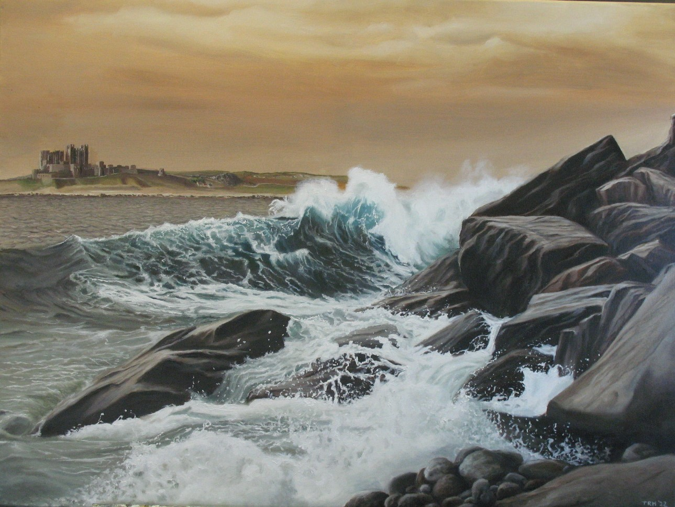

Slide 15
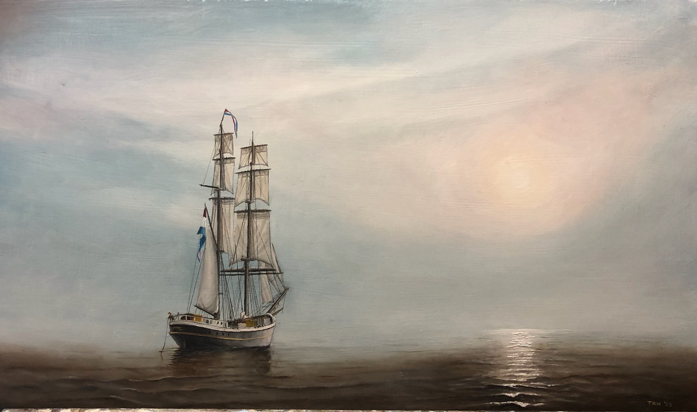

Slide 16
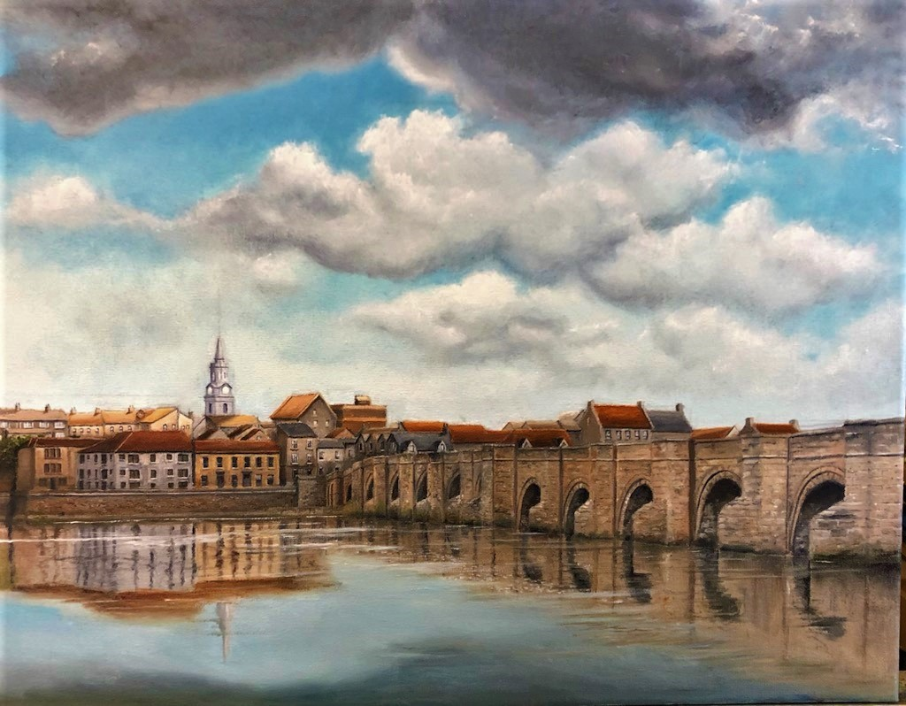
Notes:
This painting is part of my exhibition and shows the old bridge over the Tweed. It was one of the most fought over towns in Europe and has walls to prove it. This image is also a captured moment but borrowed by me! If we put it next to this landscape of Delft by Vermeer in the seventeenth century, the similarities become apparent.
Get participant responses
It is suspected that Vermeer used the technique of camera obscura (explain this) and projected the image onto a canvas, he then painted the scene in. The clouds are threatening but the background buildings are still in sunlight. I have used this idea to create a similar idea over Berwick with the light hitting the buildings in the rear of the canvas. It is a captured moment just projected forward in time and adds a little bit of drama to the scene.

Slide 17
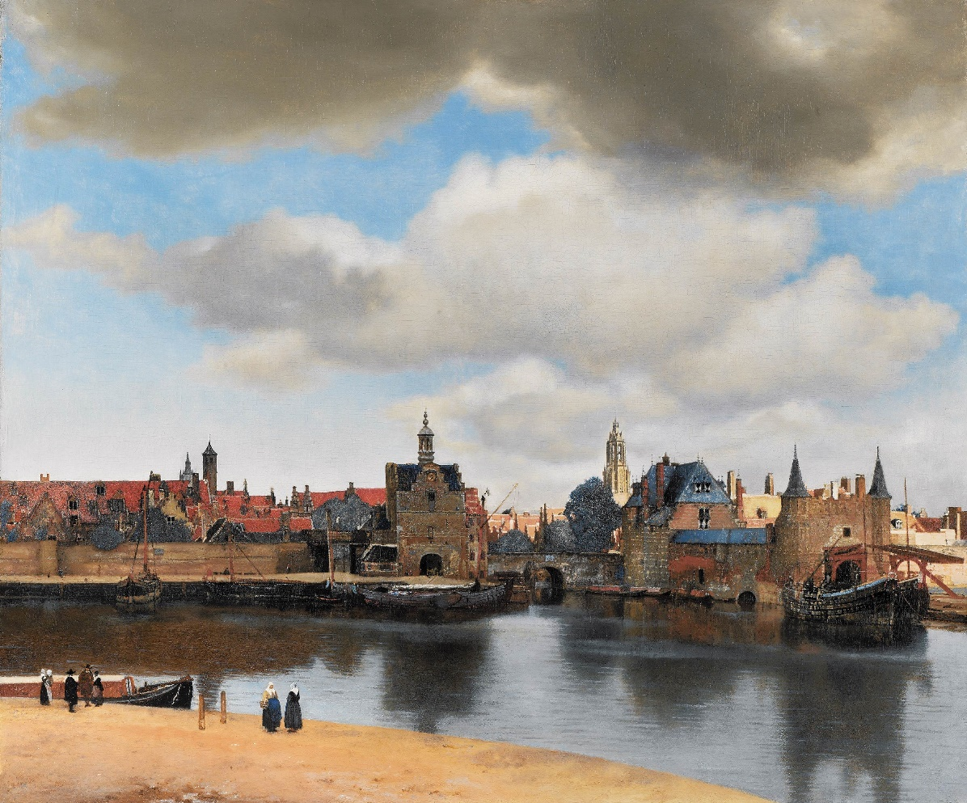
Notes:
Art reminds us that despite the pain and ugliness that exists in the world, something deeper exists, a beauty that peeks through the drudgery of life, whispering that there is more beneath the surface.
We crave art that captures truth and remains powerfully and beautifully relevant, long past the time of its creation. It is not hollow, just pretty, changing in the eye of the beholder and not just sentimental because that is fleeting. Good art through effective composition and technique captures in an astonishing and breathtaking way, moments that heighten our senses, transforming our thoughts and emotions. Painting allows me to pour the totality of myself into the process, creatively and emotionally; it shelves the noise of other concerns and worries which can dominate my mind and helps me to go beyond the daily routines in my life bringing an inner calmness and acceptance of who I am and what I am about. Art helps heal our inner scars, by taking the beauty in that everyday moment we have glanced at and turning it into an inner smile of appreciation which demonstrates that we are fully human.

