Slide 1
LuminisM Exercise
Blocking in the composition

Slide 2
Render the canvas
Take a blank white canvas and render it a neutral colour by mixing burnt umber and white oil (it matters not how much of each as long as you keep the mixture consistent when you paint it onto the canvas)
Now mix in a little liquin and paint the mixture onto the canvas and allow to dry

Slide 3
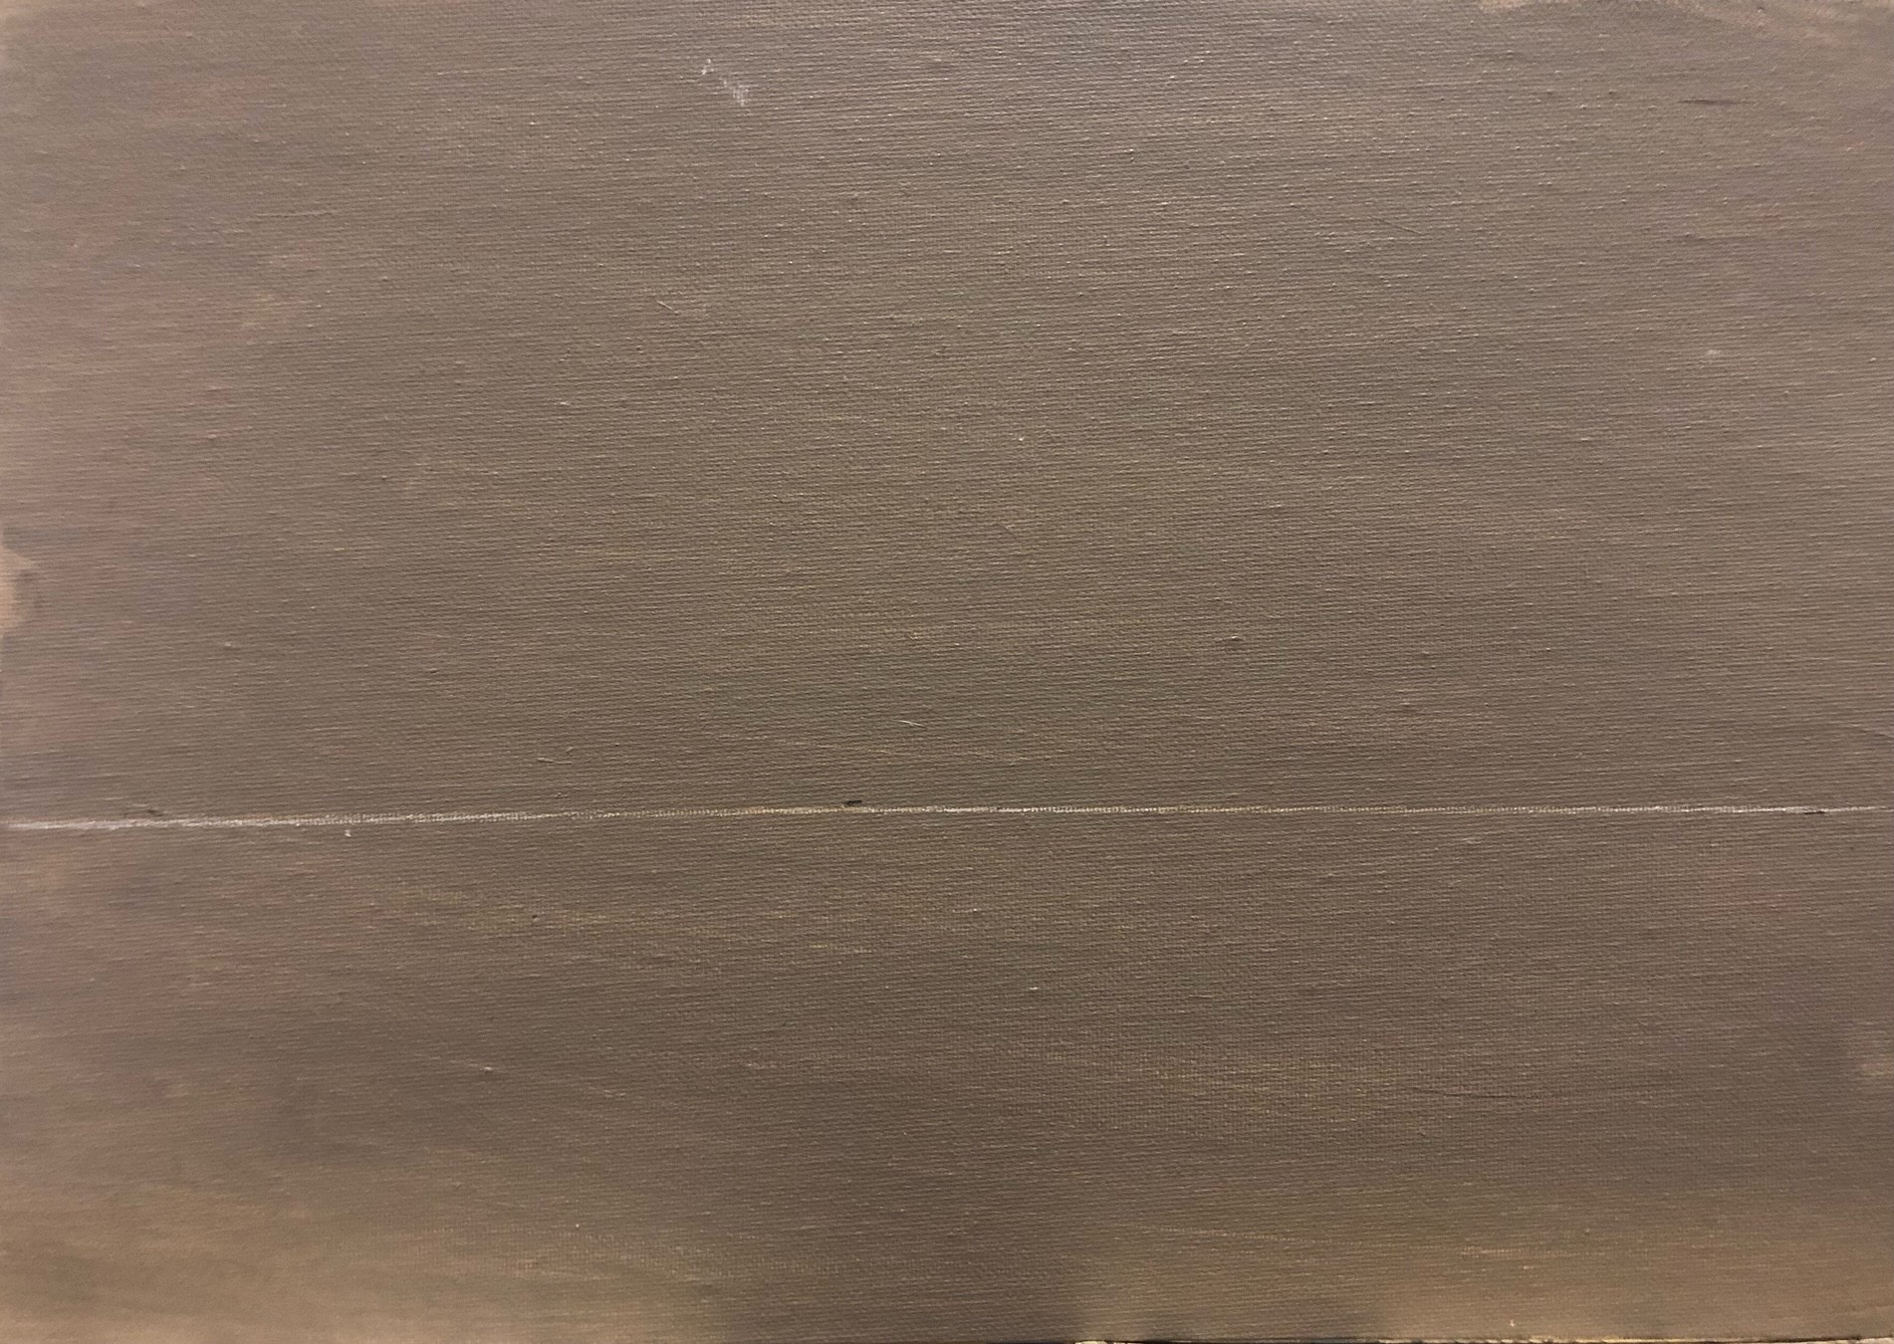
blocking in colour a)
Onto the neutral canvas draw a light line about 1/3 from the bottom of the canvas

Slide 4
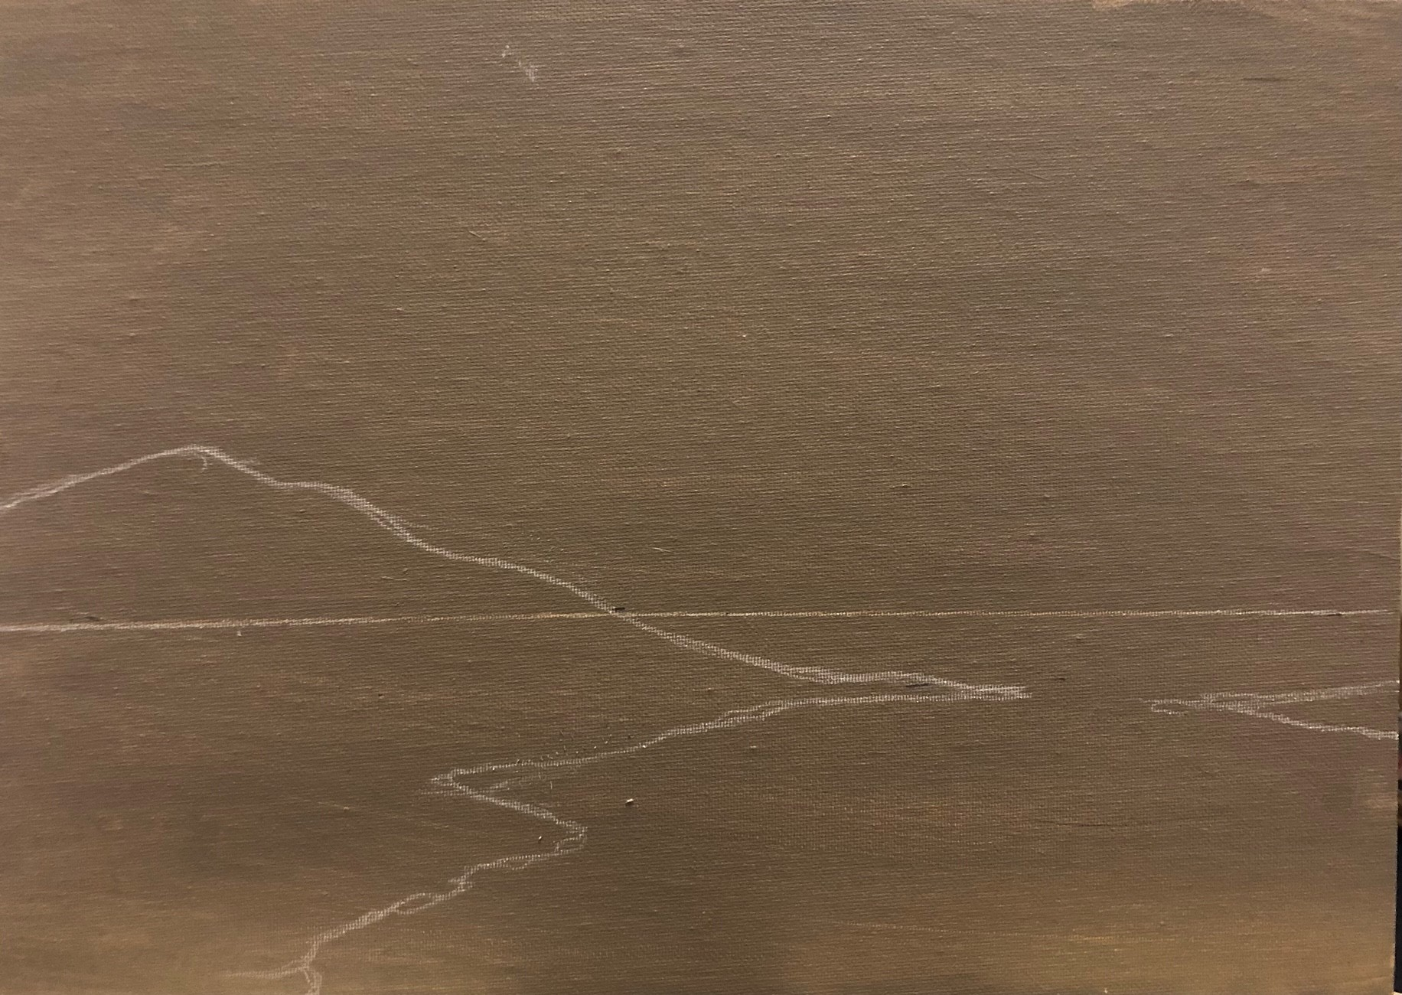
blocking in colour B)
The white line is your horizon line, now draw in the rough outline of the composition using a LIGHT PENCIL

Slide 5
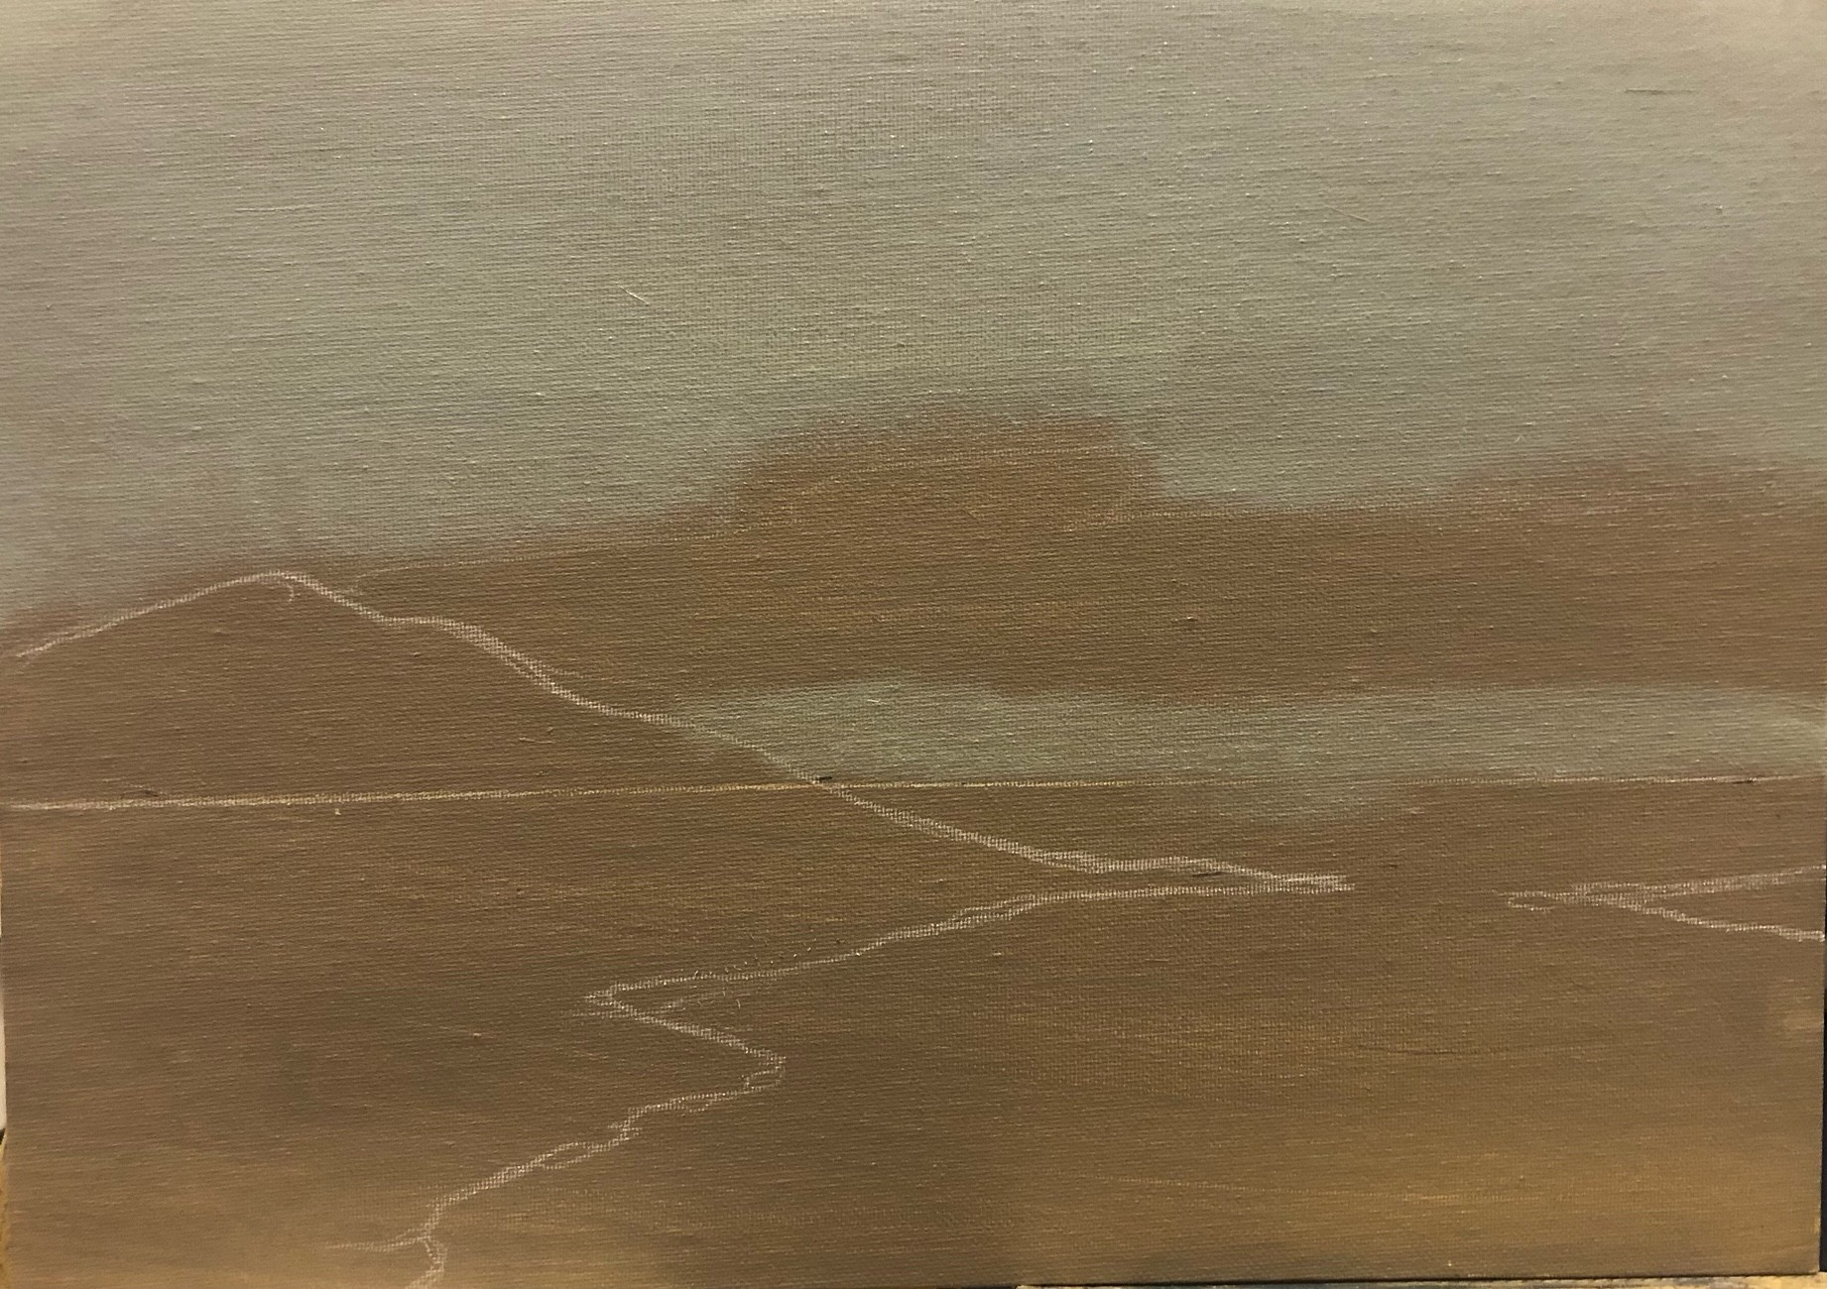
blocking in colour C)
Mix some Paynes grey with white mixing paint and dilute to a thin paint with liquin medium.
Now paint in the rough background as shown which will roughly outline the lighter part of the sky

Slide 6
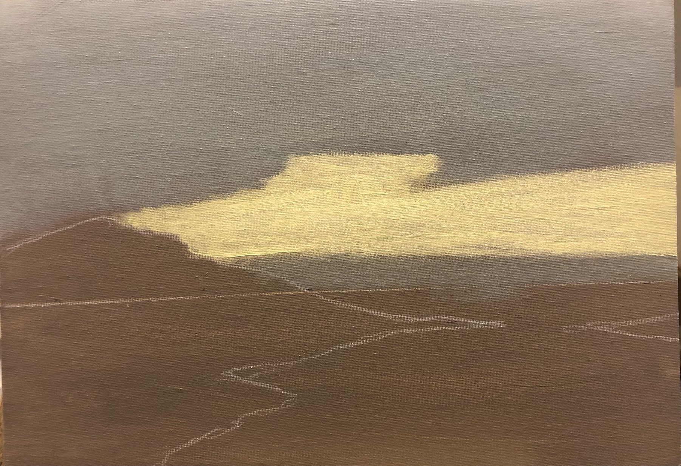
blocking in colour D)
Mix together a little lemon yellow , medium yellow, white mixing paint and liquin to create a thin paint.
Block in the light sky just above the horizon to about a centimetre above the horizon. This will leave a strip of grey underneath

Slide 7
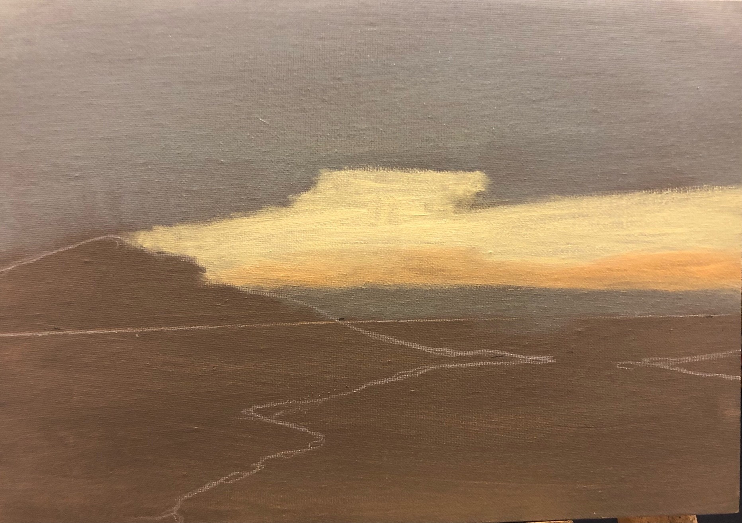
blocking in colour E)
Mix a little burnt sienna with a little medium yellow and apply just to the base of the yellow cloud

Slide 8
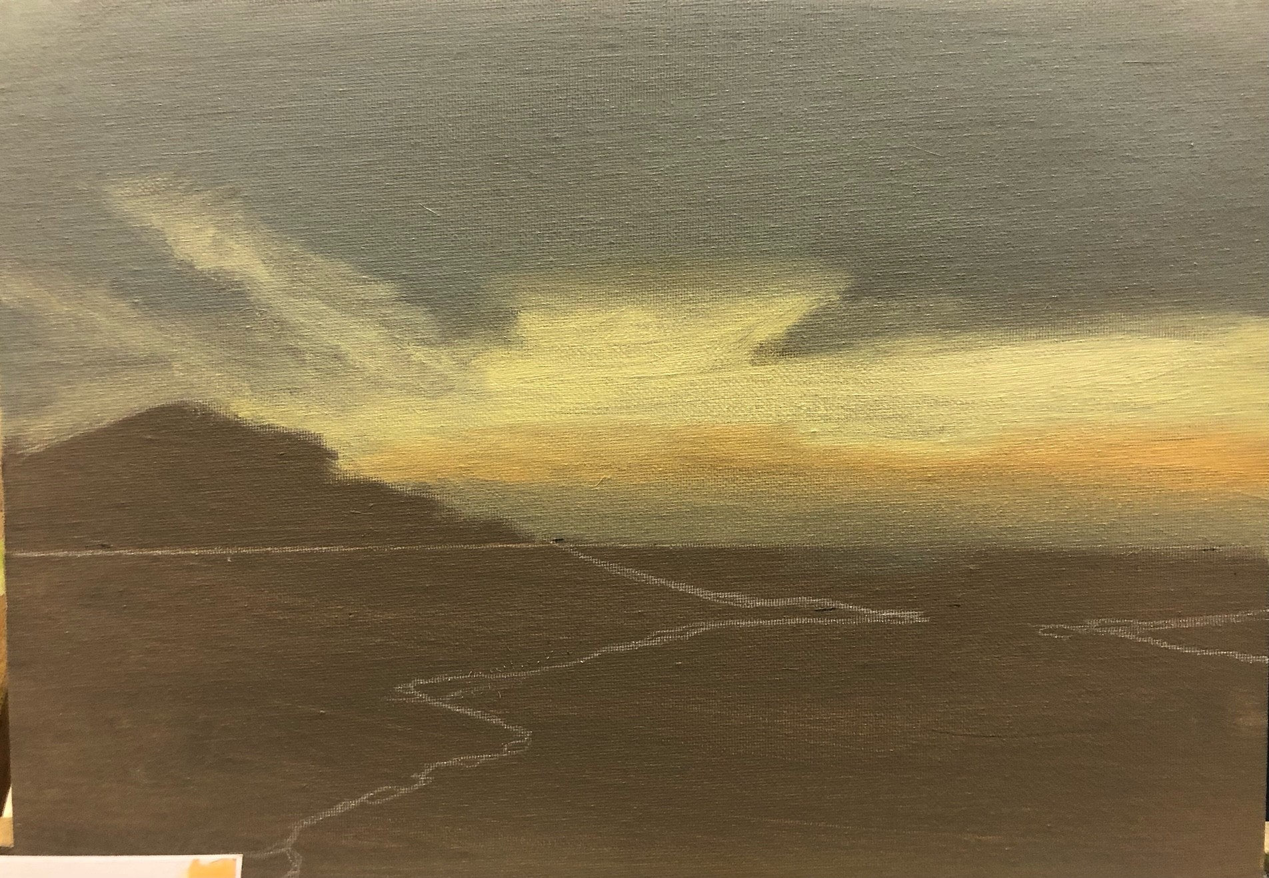
blocking in colour F)
Blend the red sienna mixture into the grey below and into the yellow above
Thinly extend two lemon fingers into the grey sky

Slide 9
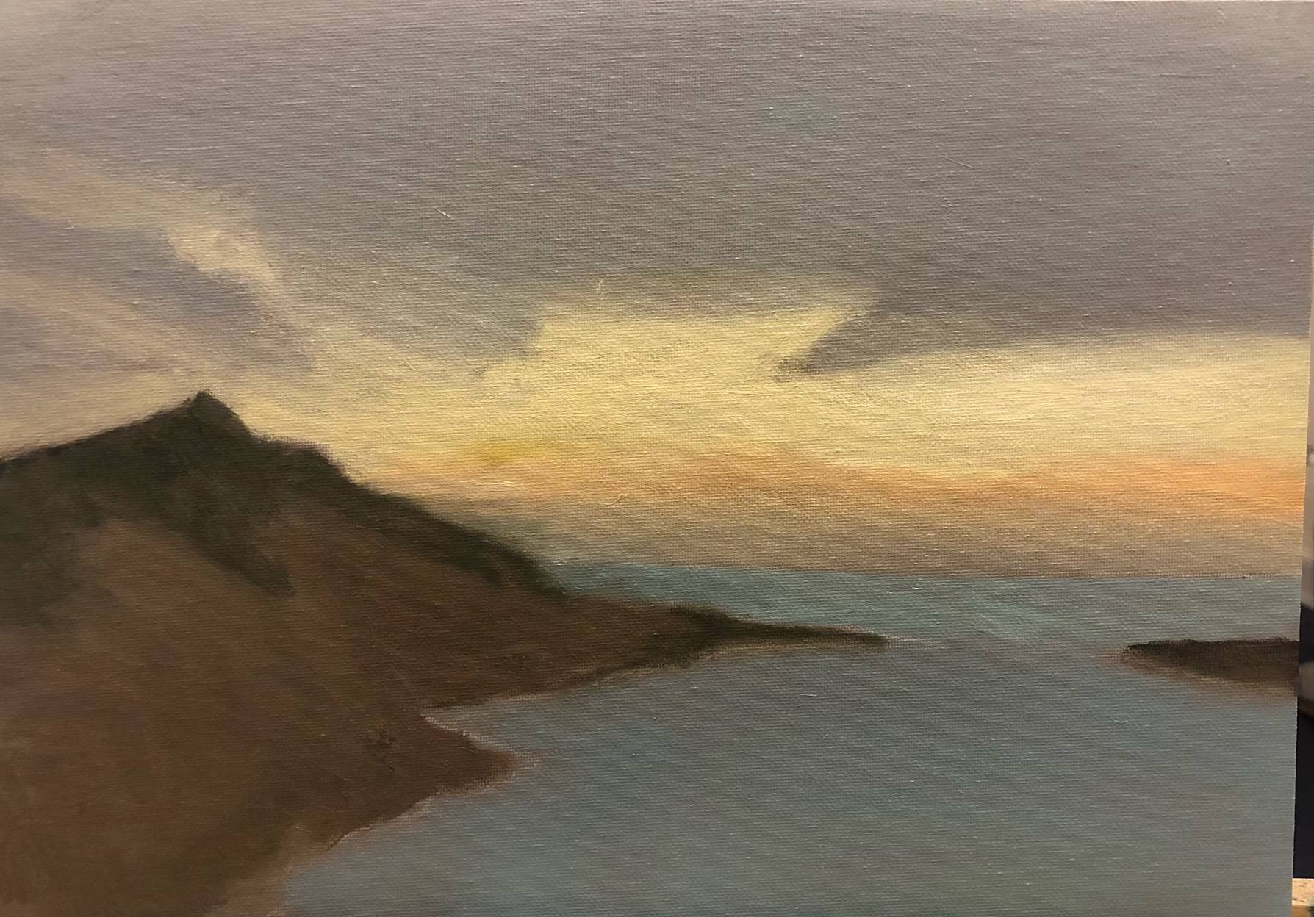
blocking in colour G)
Mix together Payne’s grey, a tiny amount of Phthallo blue, mixing white and as much liquin medium to create a thin paint and block in the water
Mix burnt umber a tiny amount of ivory black , mixing white and as much liquin to create a thin paint and block in the land shapes.
Finally mix sap green with a little ultramarine blue and as much liquin and block in roughly the grass on the hill summit

Slide 10
LUMinist exercise
Modelling the sky

Slide 11
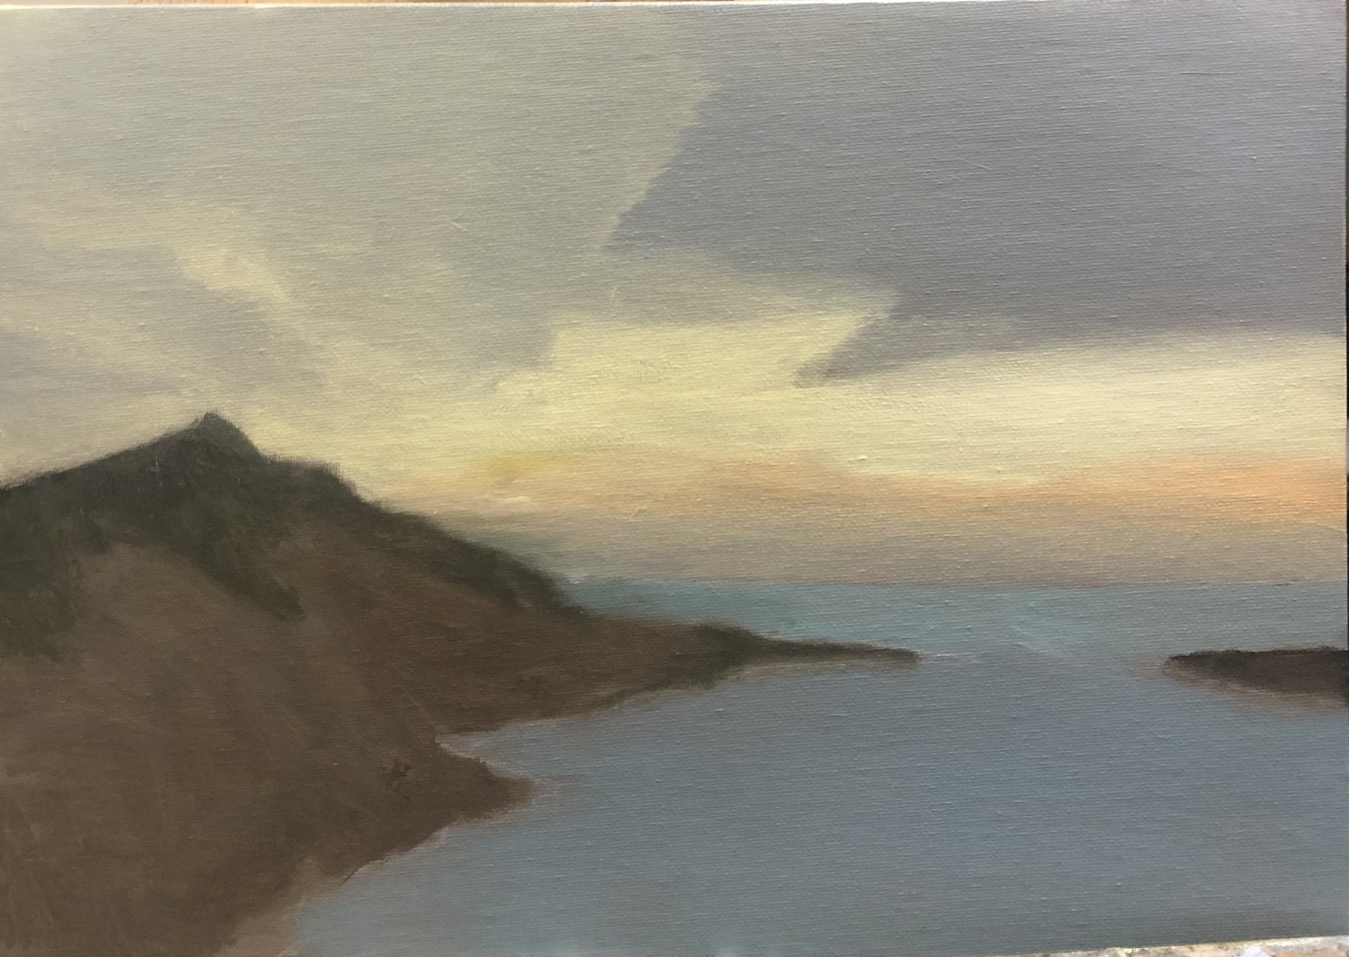
MODELLING A
Mix a little lemon yellow with more white
Take some of the mix and mix with a greater proportion of liquin
Apply the glaze to the left- hand area of the sky

Slide 12
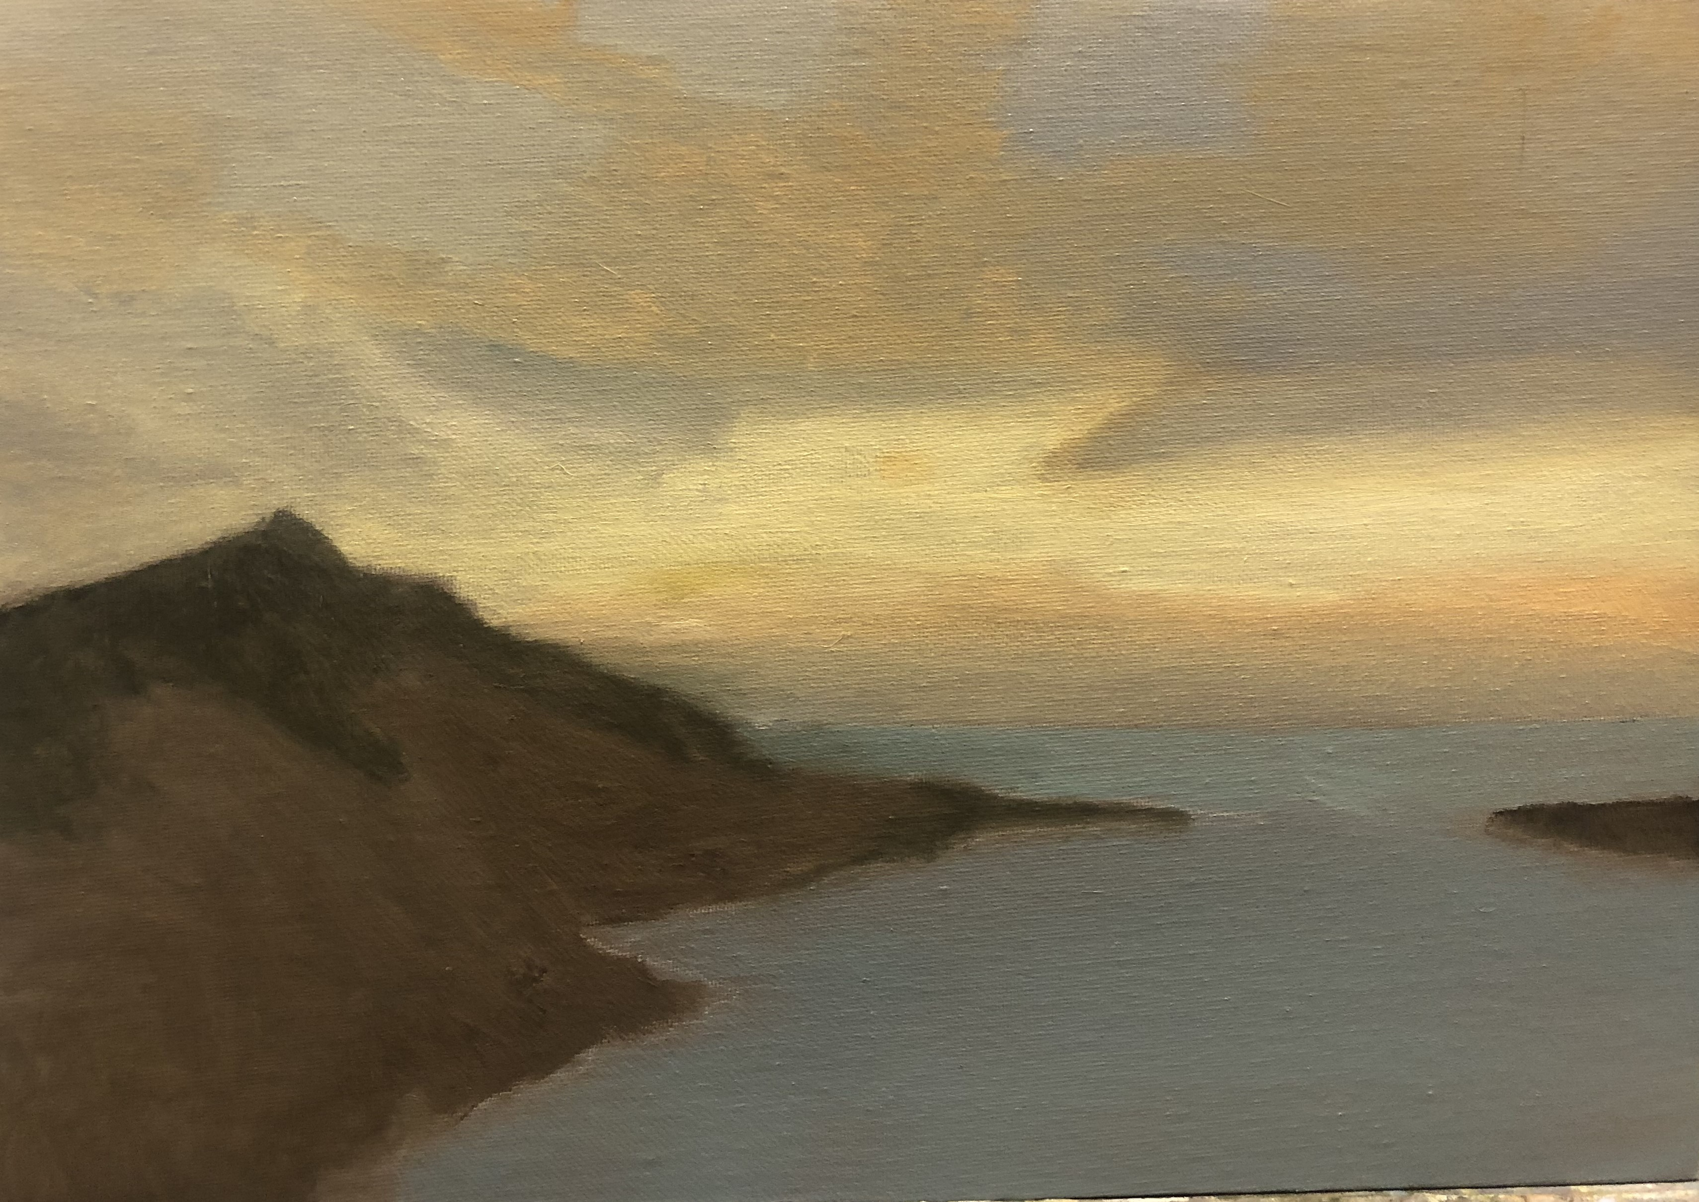
MODELLING b
Mix some burnt sienna with a little mid-yellow pigment
Mix with as much liquin and apply thinly to the sky to form the rough shapes of the sun-reddened clouds

Slide 13
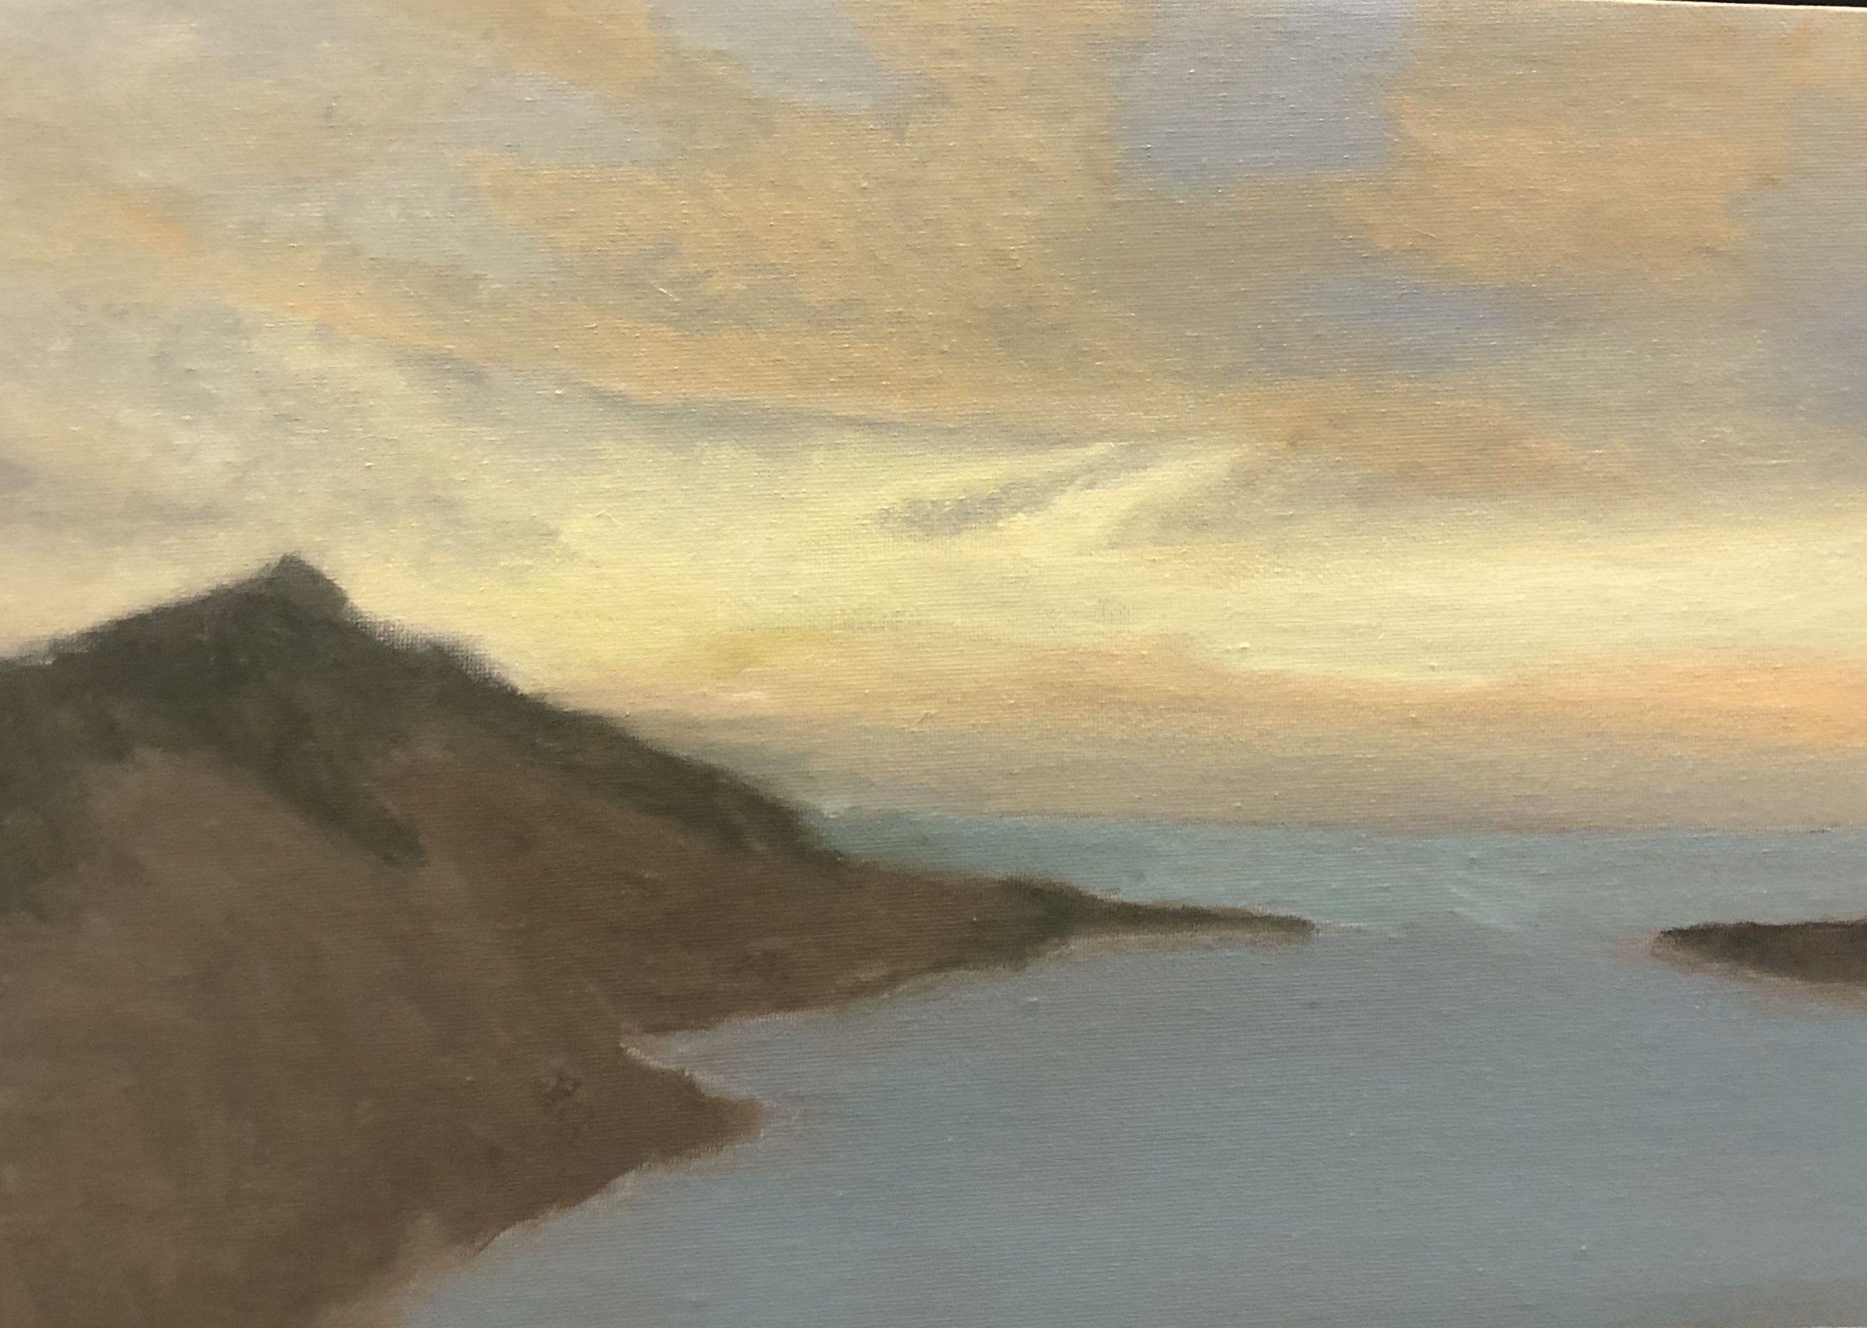
Modelling c
Take most of the paint from your brush and blend all the edges of the cloud into the surrounding grey on the right and glaze on the left
Make up some light lemon (lemon and white) and add a touch of mid- yellow mix with more liquin than pigment and put a touch on your brush and blend the lemon the lower left into the glaze below it
Using a small brush put a thin stripe of lemon onto the base of the long sienna cloud and blend it into the sienna above it an the grey below it

Slide 14
MODELLING d
Mix a little paynes grey with white and liquin to make the same tone as the underlying grey of the sky. Using a small brush and paint in to the central lemon cloud to cretate a ‘jagged tooth’
Make a thin glaze mixture of burnt sienna, mid-yellow and white and more of the liquin (more liquin compared to pigment paint over the region between the lemon and sienna clouds on the right

Slide 15
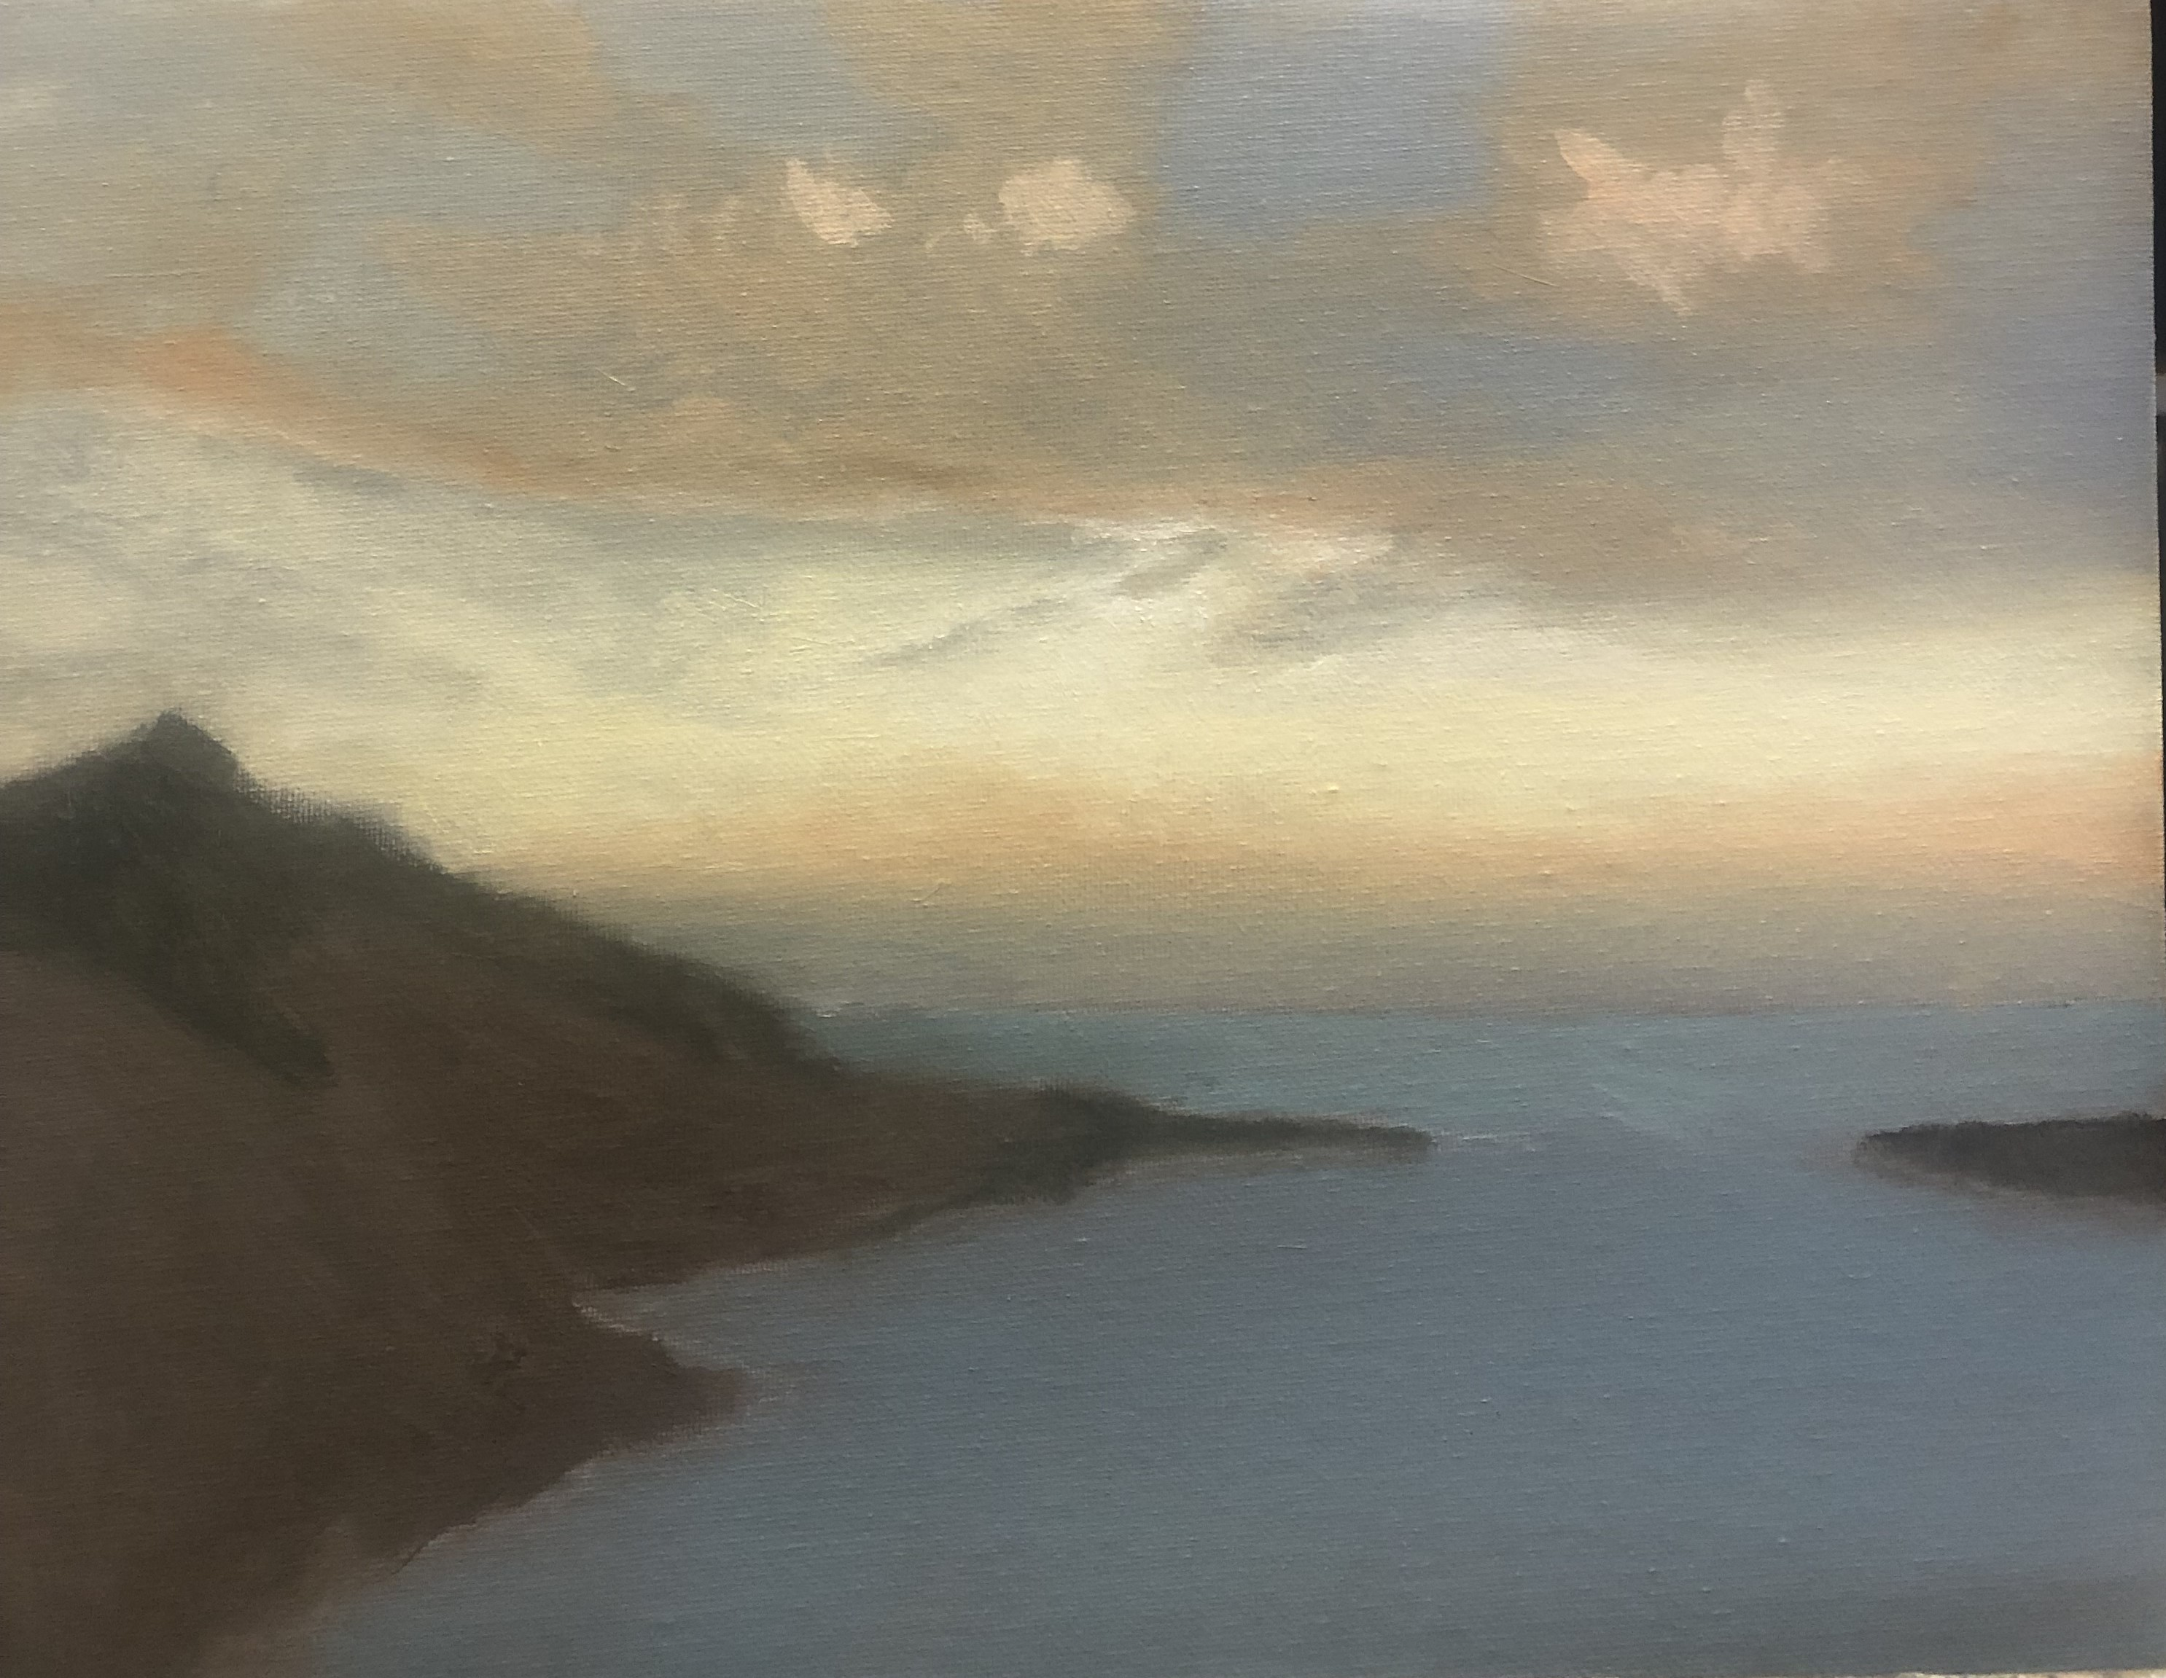
Modelling e
Add lemon highlights to sky

Slide 16
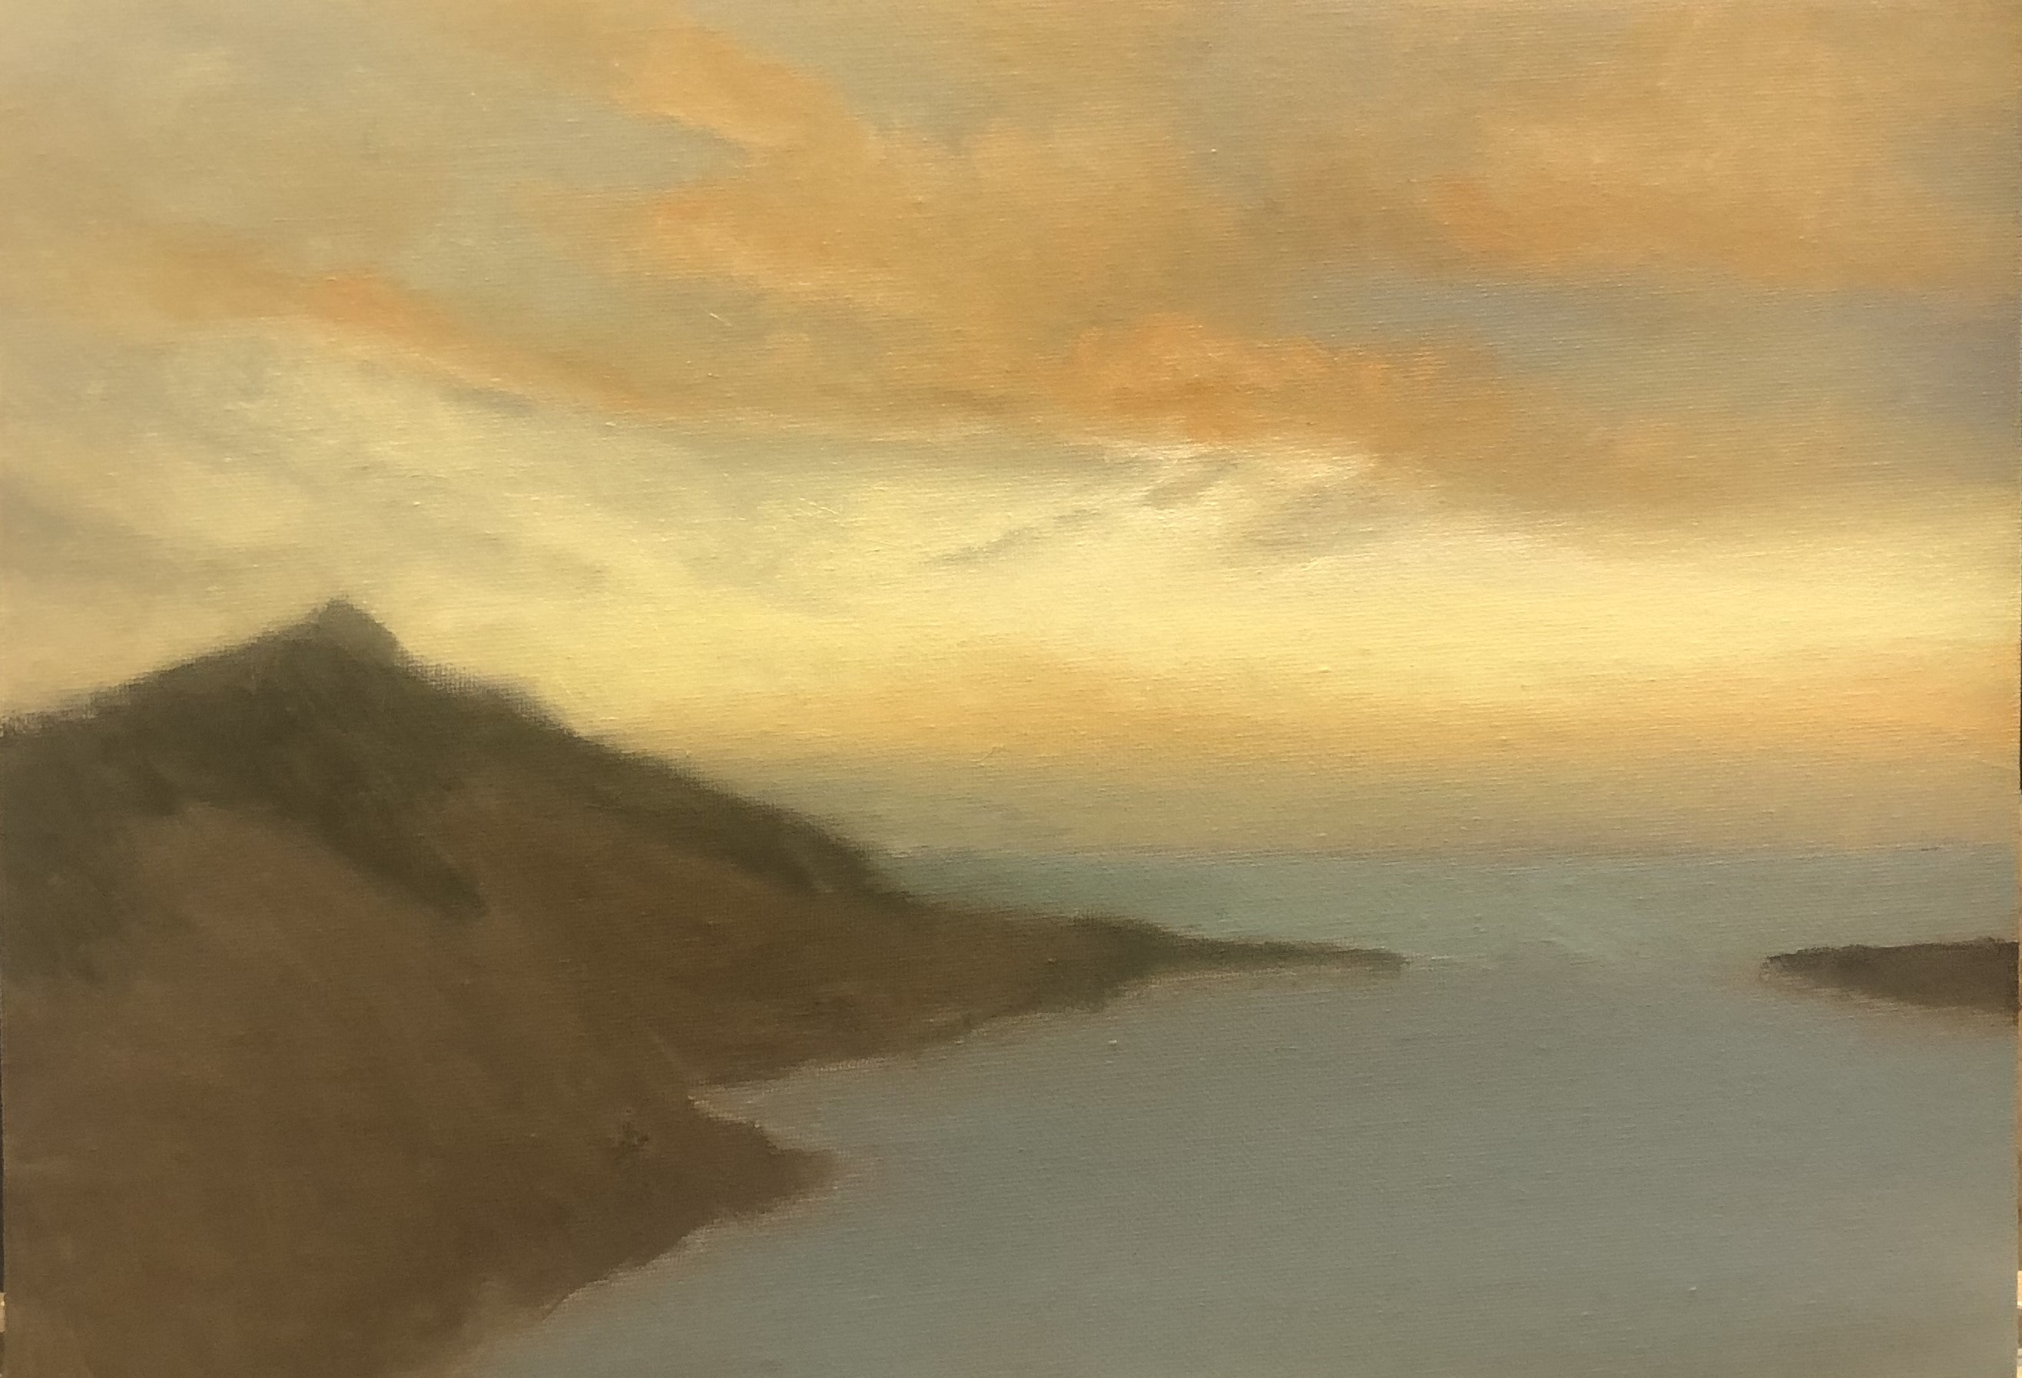
Modelling f
Blend into sienna clouds

Slide 17
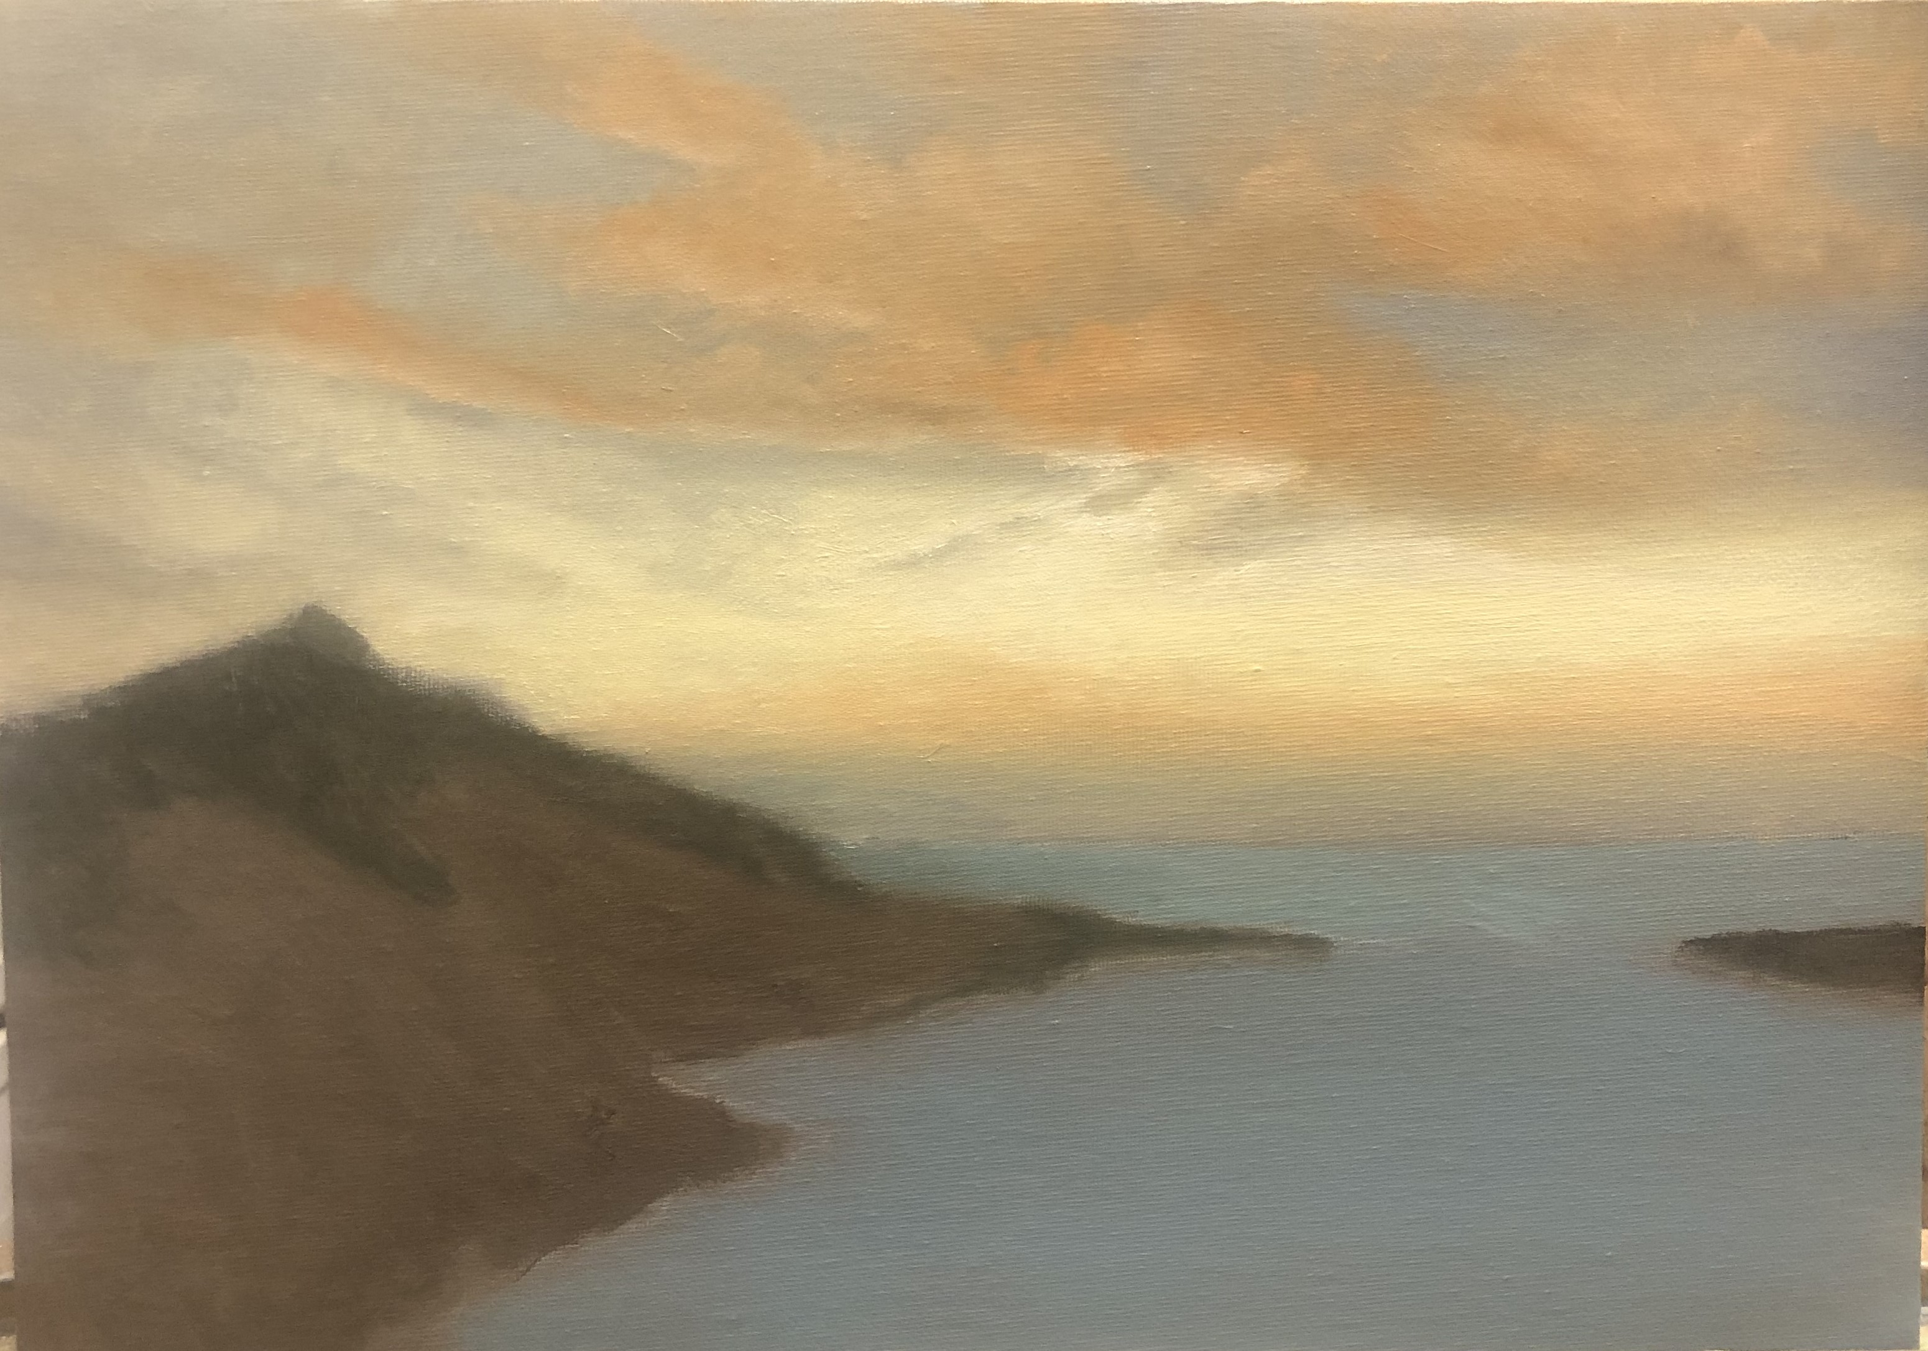
Sky detail A
Lighten upper right clouds with mixture of lemon and sienna

Slide 18
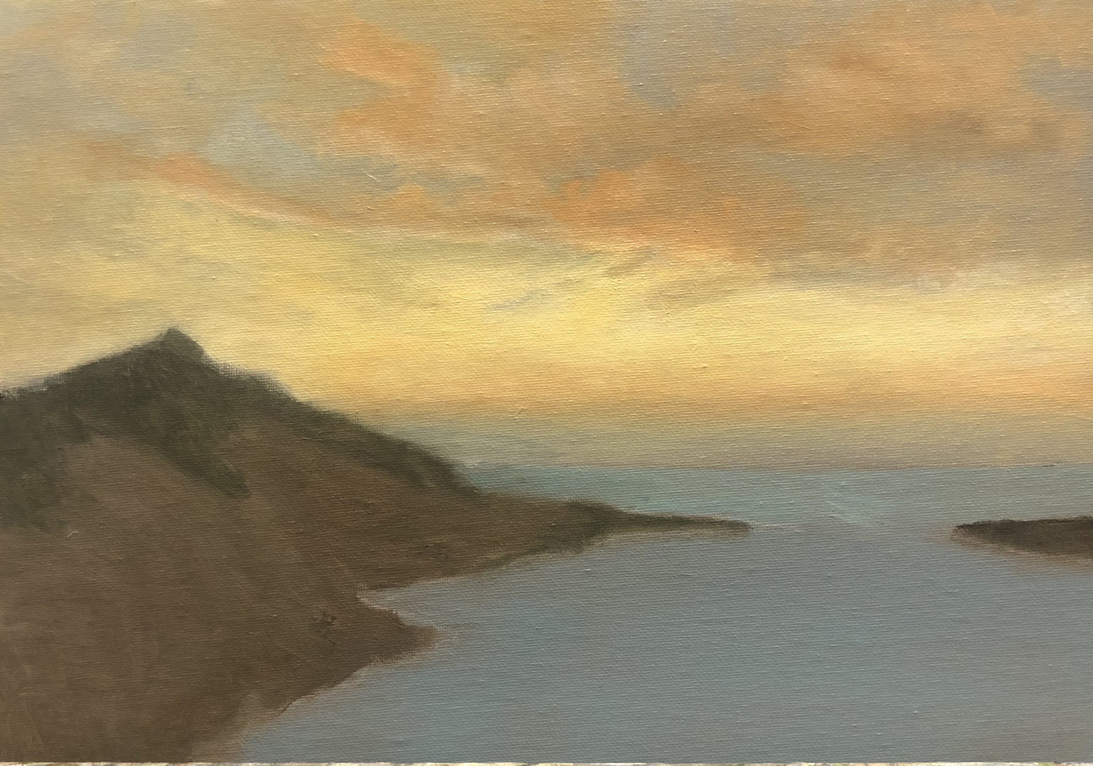
Sky detail B
Reinforce under highlight on left cloud
Blend into upper cloud
Warm lemon clouds by scumbling with mid-yellow

Slide 19
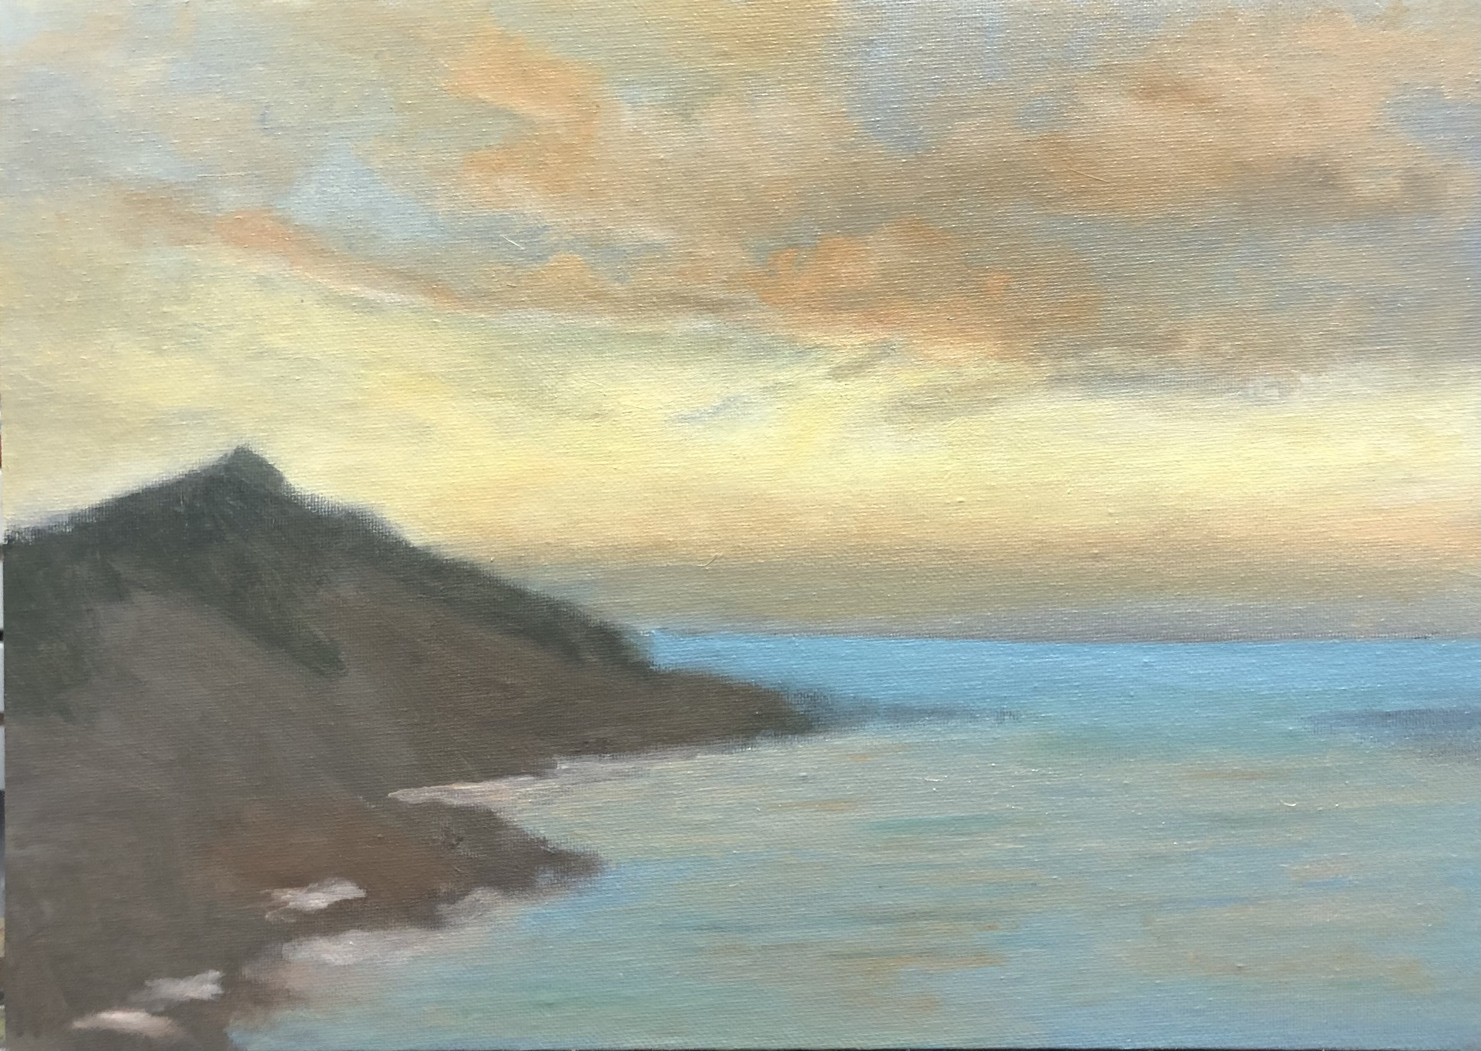
Water detail C
Glaze lower section of water with mixture of sienna yellow, cadmium red and white

Slide 20
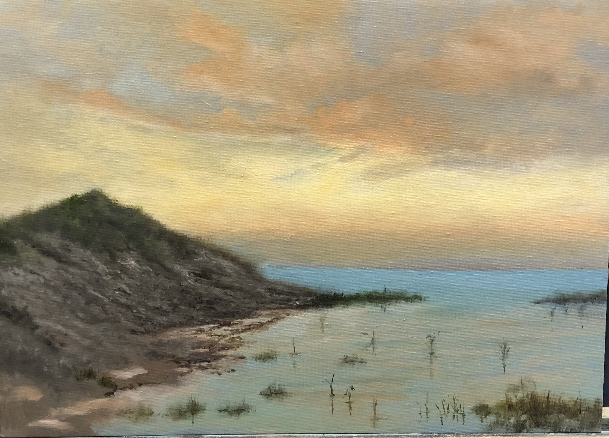
Fine DETAIL A
Using splayed brush add texture to the coarse grass on the bank, mix sap green, black and white in varying amounts to create shadow and lighter areas
Mix burnt umber black and white and create texture on bank, shadow areas light areas and stones. Use small brush.

Slide 21
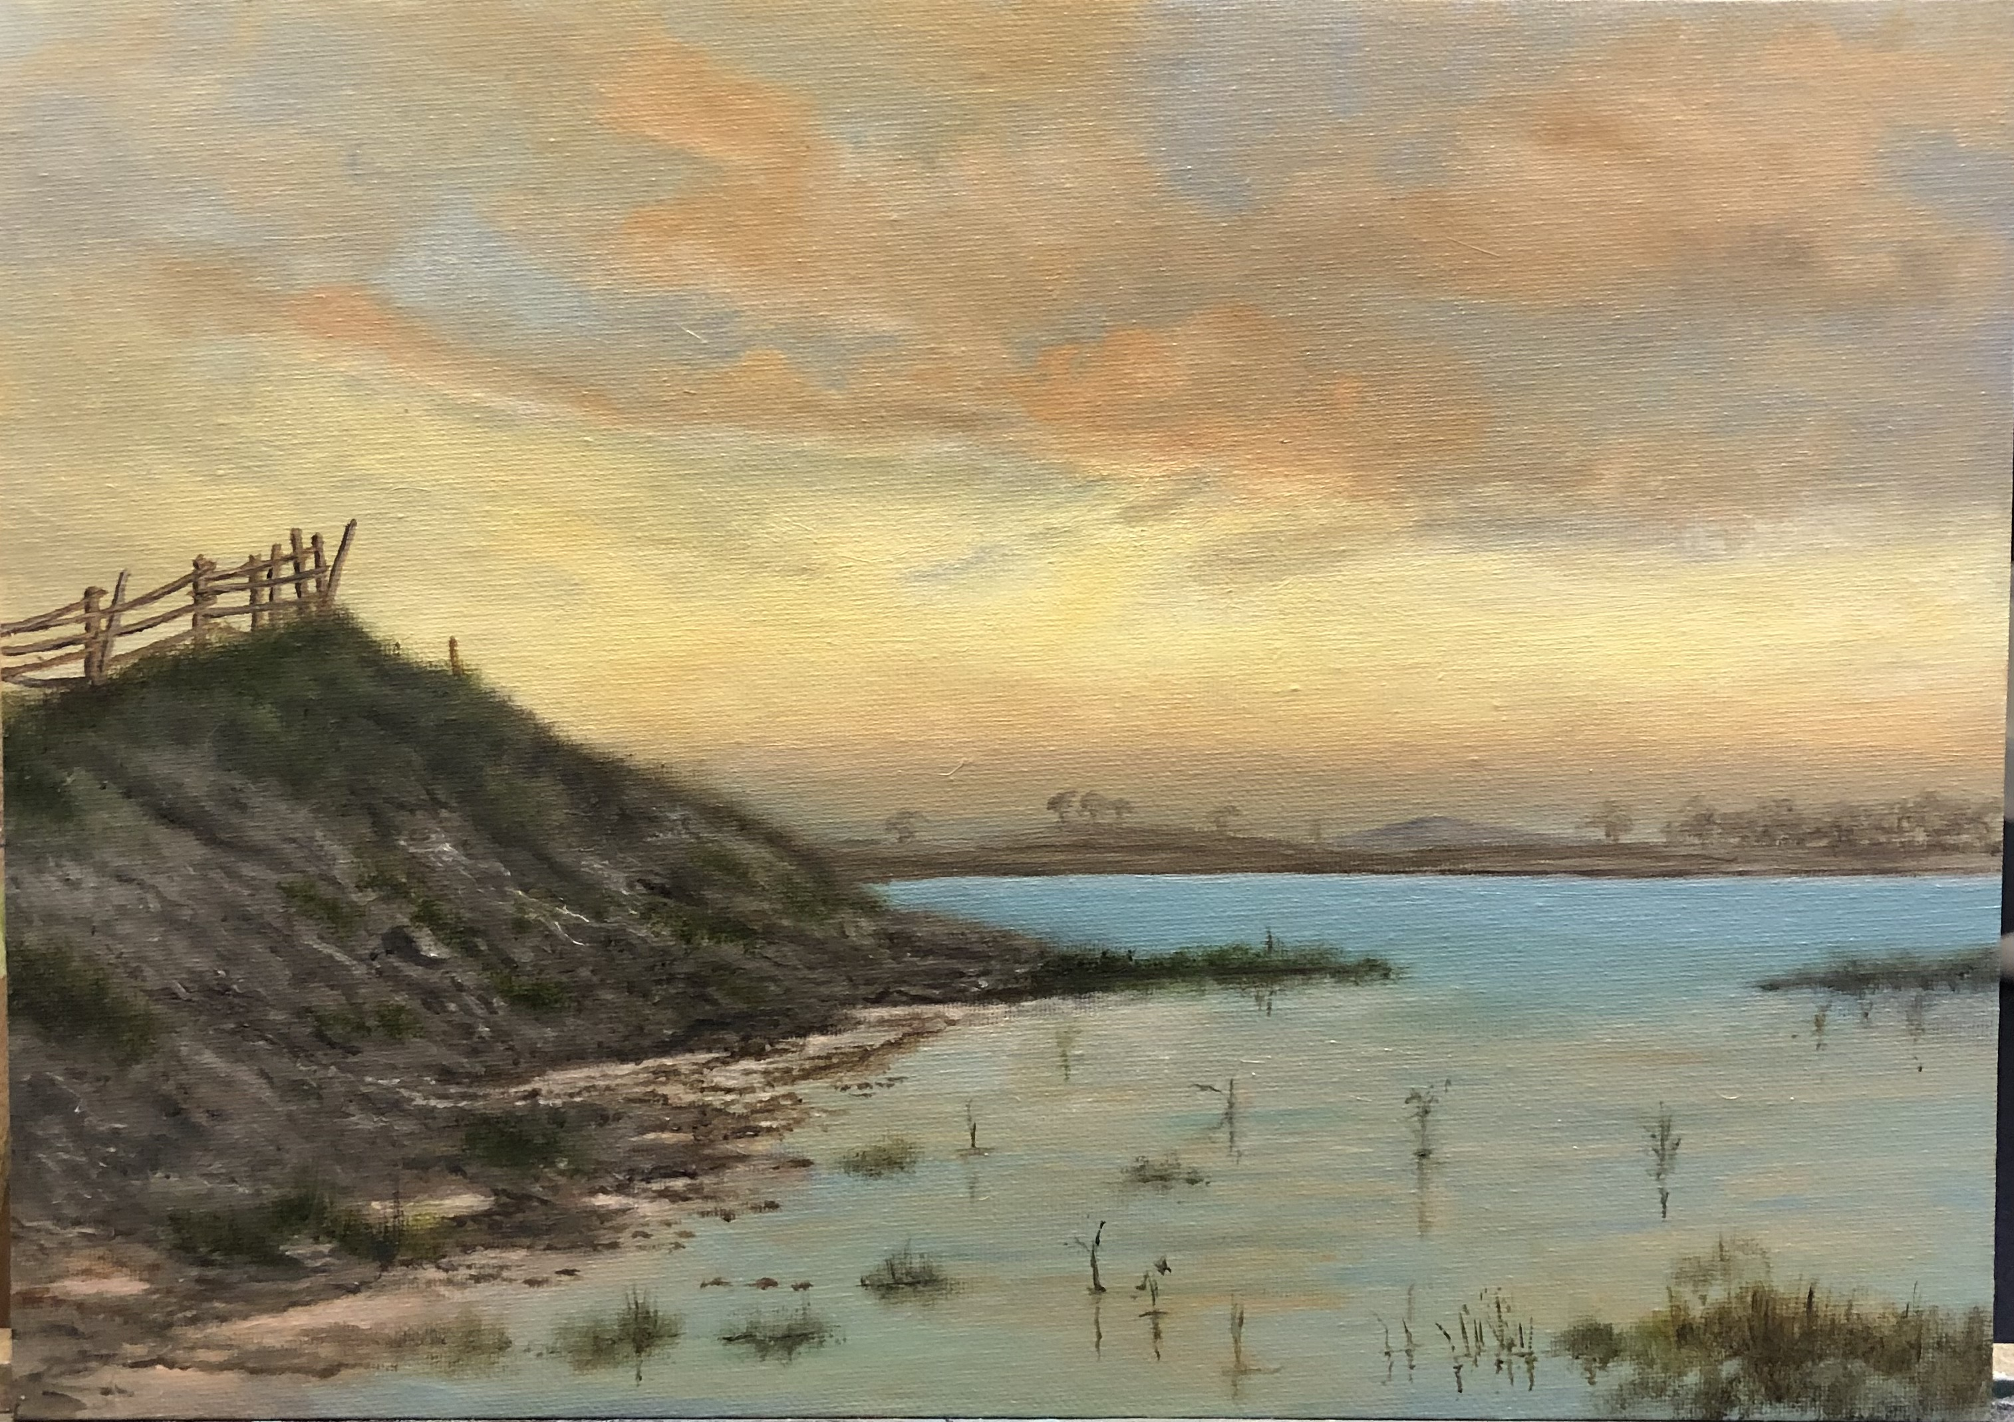
Fine DETAIL B
Using mixture of black sap green and white and splayed brush add more clumps of coarse grass on bank.
Use 3B or 4B add more detail to texture of muddy bank
Paint in shadow edges on muddy pools
Using burnt umber, white and black paint in fence using small brush
Using mixture of small amount of burnt umber and white paint in land on horizon
Use Paynes grey and ore white paint in hill in background
Use fine 000brush to paint in trees using ixture of raw umber and white

